Slide 1
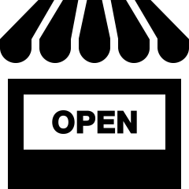
Doughnut Design for business
Introduction to redesigning businesses through Doughnut Economics
Erinch Sahan (January 2023)

Slide 2
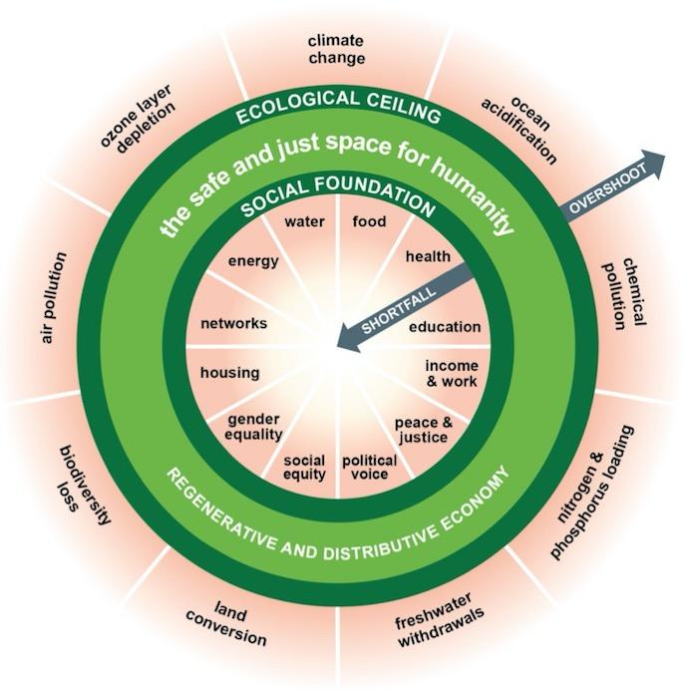
A compass for human prosperity
Notes:
The Doughnut consists of a social foundation, to ensure that no one is left falling short on life’s essentials, and an ecological ceiling, to ensure that humanity does not collectively overshoot the planetary boundaries that protect Earth's life-supporting systems. The doughnut-shaped space between these boundaries is where humanity can thrive. In essence, Doughnut Economics calls on businesses to demonstrate how they are going to transform so that they will belong a future that is in the Doughnut – aligned to, and in service of, a world where all people and the living planet thrive.
Reaching this scale of ambition calls for transforming not only the design of products, but the deep design of business itself.

Slide 3
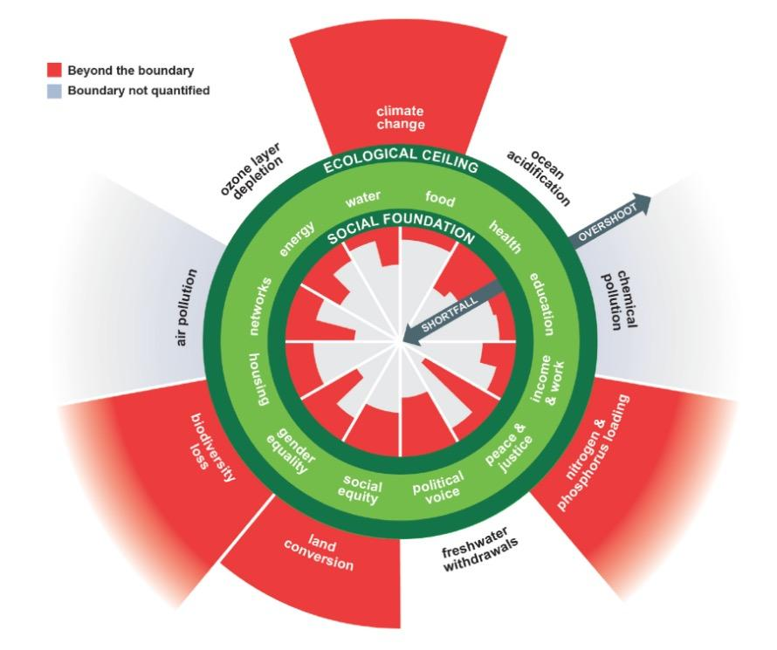
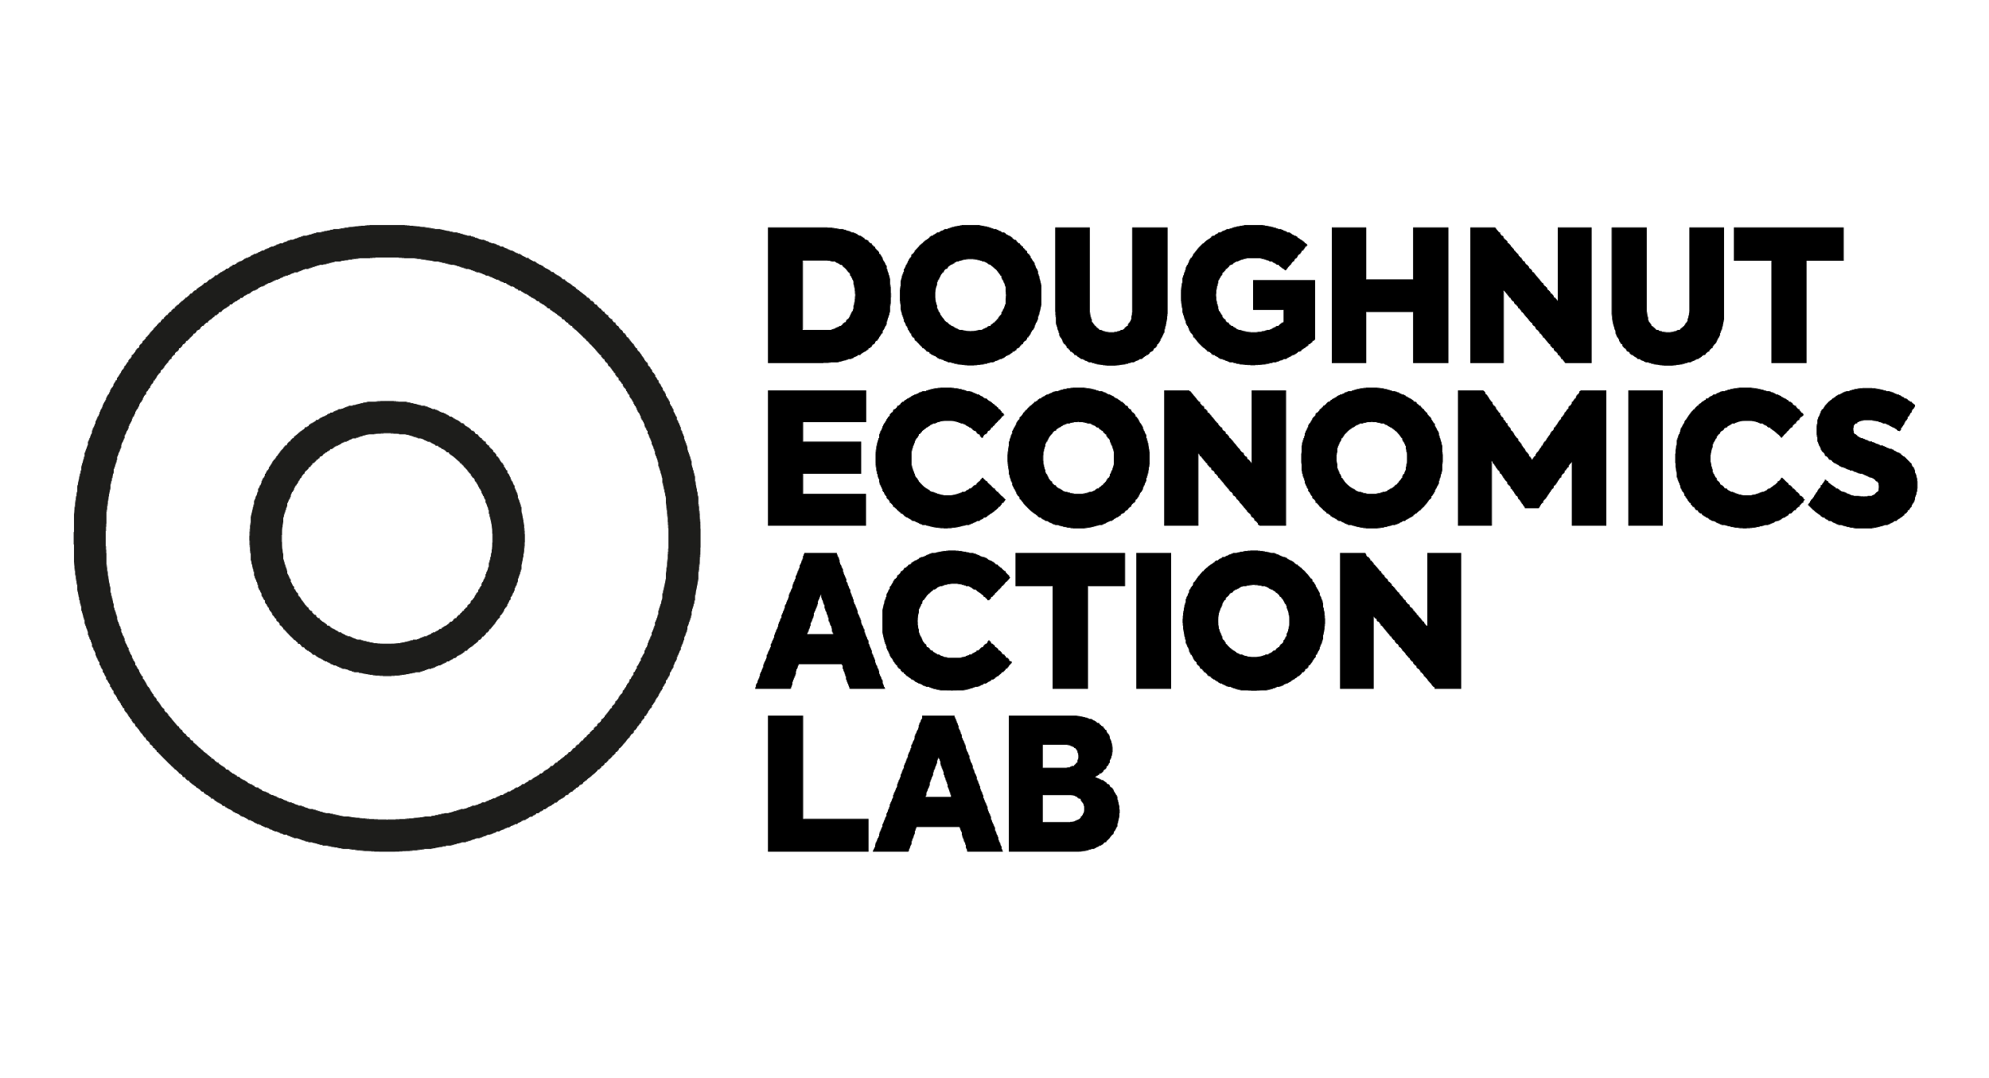
A world perilously out of balance

Slide 4
To change the future, change the dynamics
take
take
make
make
regenerate
biological
materials
restore
technical
materials
use
use
lose
lose
Degenerative
Running down Earth’s life-supporting system
Regenerative
Working with and within the cycles of the living world
‹#›

Slide 5
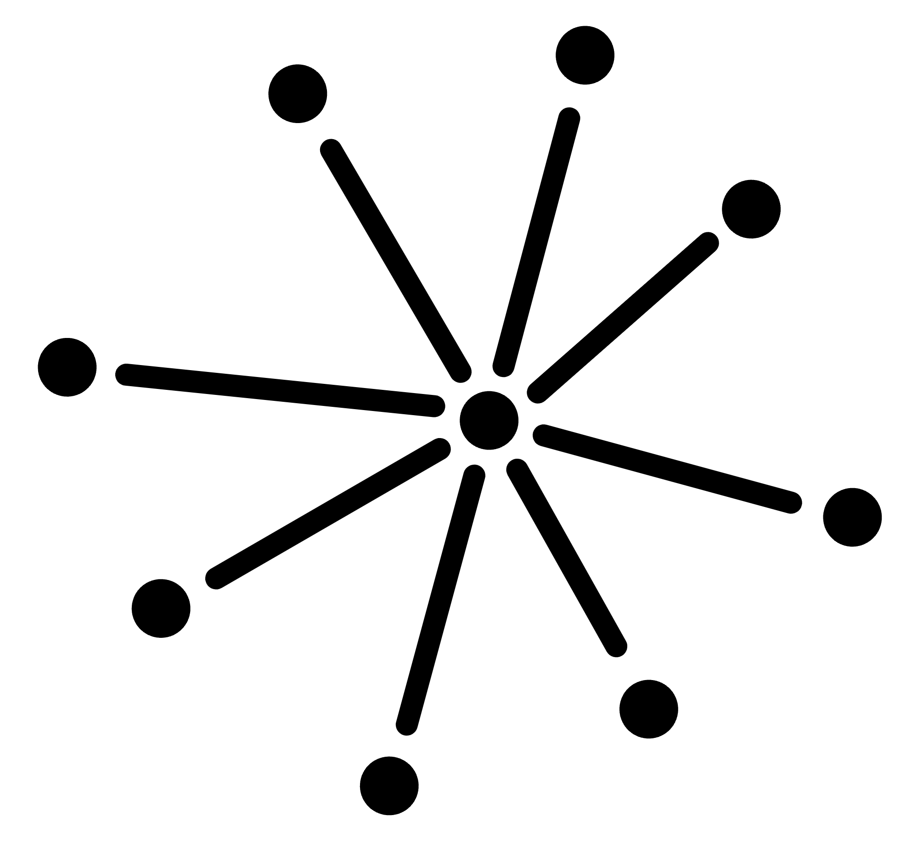
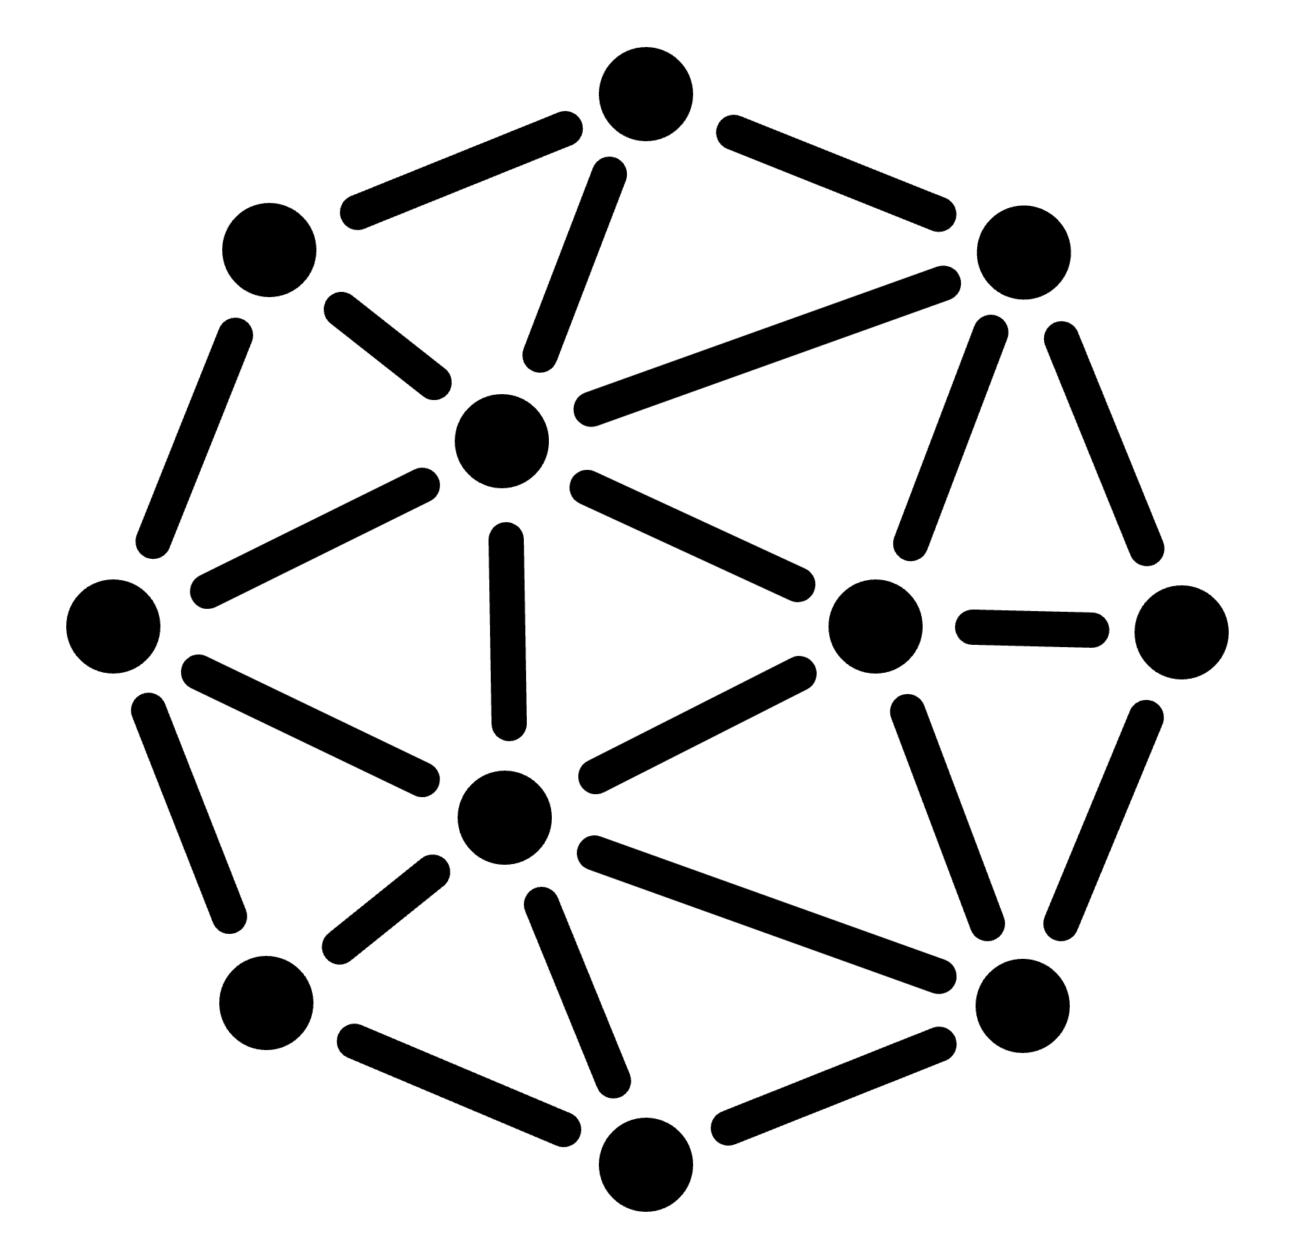
To change the future, change the dynamics
Divisive
Capturing opportunity and value in the hands of a few
Distributive
Sharing opportunity and value with all who co-create it
‹#›

Slide 6
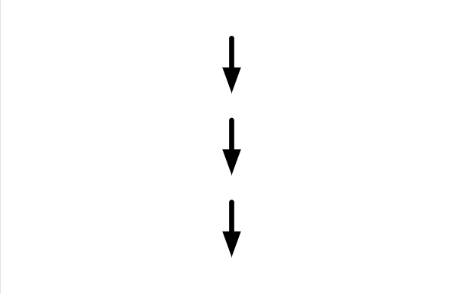
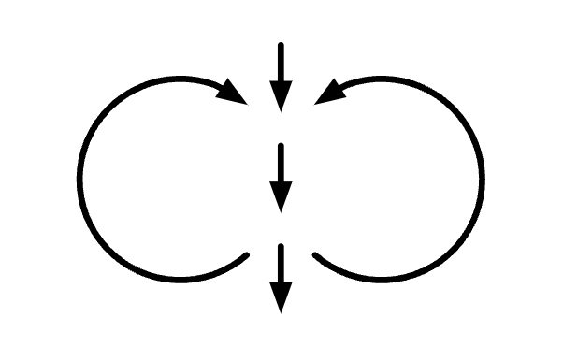
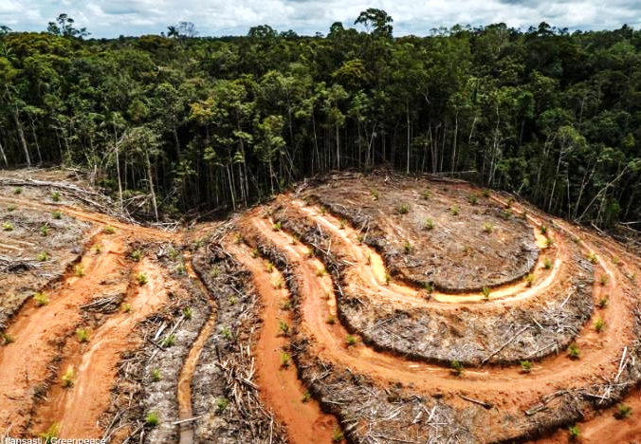
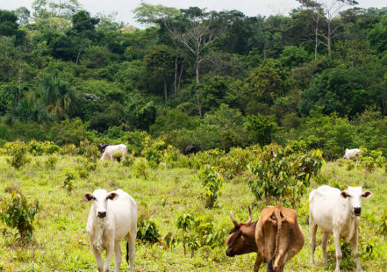
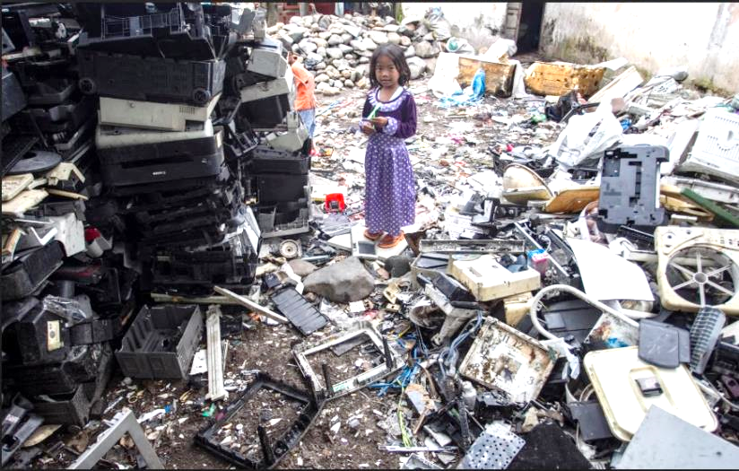
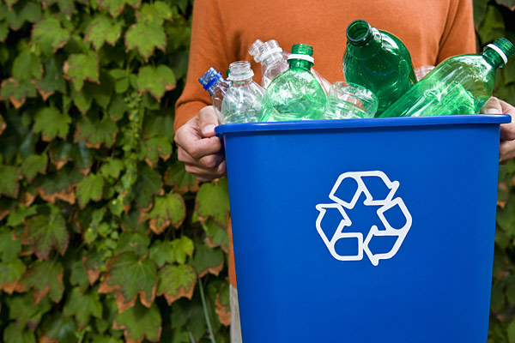
Degenerative
Sustainable
Regenerative
Landscape degradation
Zero deforestation
Landscape restoration
Built-in obsolescence
100% recyclable
Repair & modular design
‹#›
Notes:
The journey from Degenerative must not end at minimising or eliminating harm. We can look to nature for inspiration here, and try to be regenerative. It’s about going beyond eliminating deforestation, or recycling our plastic – actions usually deemed to be sustainable. We must undo the damage we have done, while creating systems that design away waste (like modular product design) and improve the health of our natural ecosystems.

Slide 7
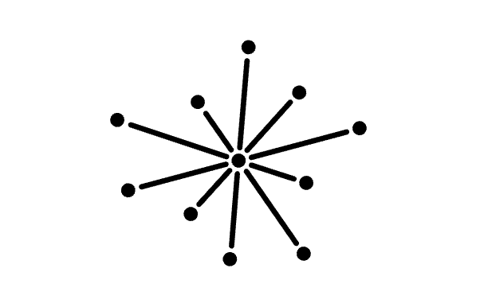
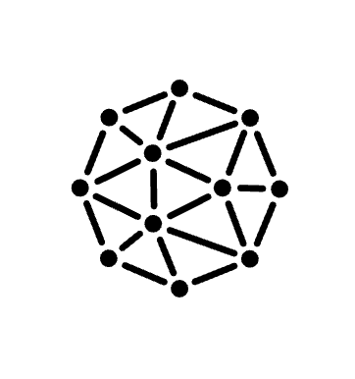
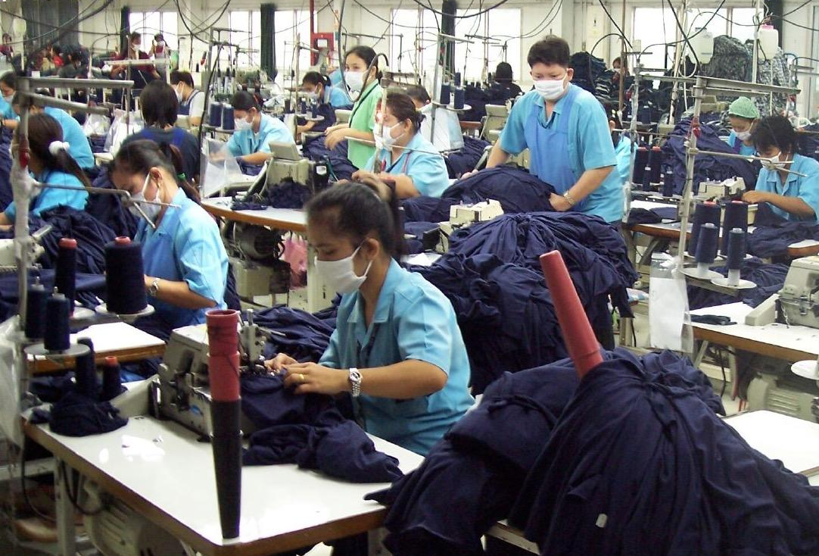
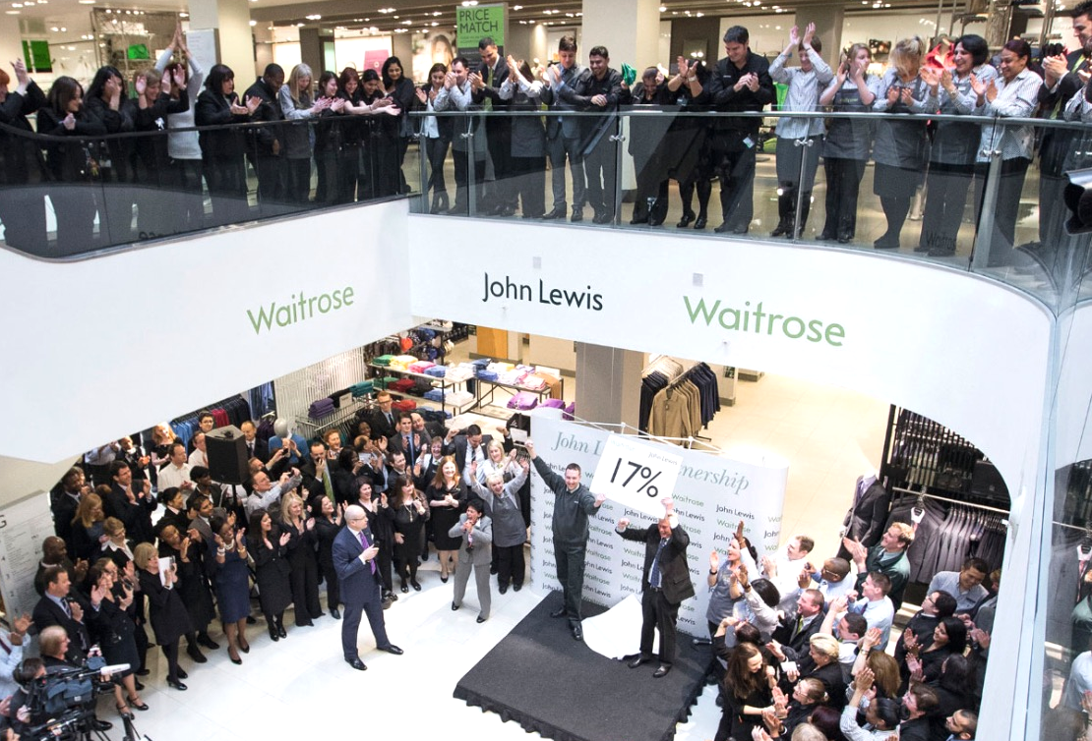
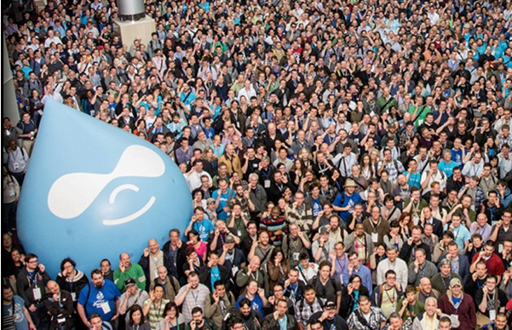
Divisive
Inclusive
Distributive
Poverty wages
Living wage
Living wage and profit share
Aggressively enforced patents
Technology partnerships
Open source design
‹#›
Notes:
Similarly, the journey from Divisive must not end at being inclusive. The goal is to distribute value and opportunity, going beyond – for instance - providing just enough for workers through a living way, to (for instance) profit sharing models in employee-owned businesses). We can also evolve away from a culture of hyper-competition, and move even beyond partnerships. We can make our ideas and technologies open source (like Drupal does in technology, and the outdoor clothing company Houdini does with its designs).

Slide 8
What can block transformative ideas?
What can unlock transformative ideas?
outdated processes
suspending practicality
rigid financial targets
broad perspectives
short-term thinking
long-term thinking
culture of hierarchy
culture of courage
Degenerative
Divisive
Regenerative
Distributive
‹#›
Notes:
What holds back these regenerative and distributive ideas from being pursued by all businesses? DEAL worked with 100s of businesses to identify key barriers.
The businesses held back from pursuing transformative ideas had these in common: outdated processes, rigid financial targets, short-term thinking and a culture of hierarchy.
The businesses able to pursue transformative ideas had these in common: they suspended practicality to explore ambitious ideas, brought in much broader perspectives from across stakeholders they impacted, they practiced long-term thinking, and fostered a culture of courage so transformative ideas were generated by staff at all levels as well as all stakeholders.

Slide 9
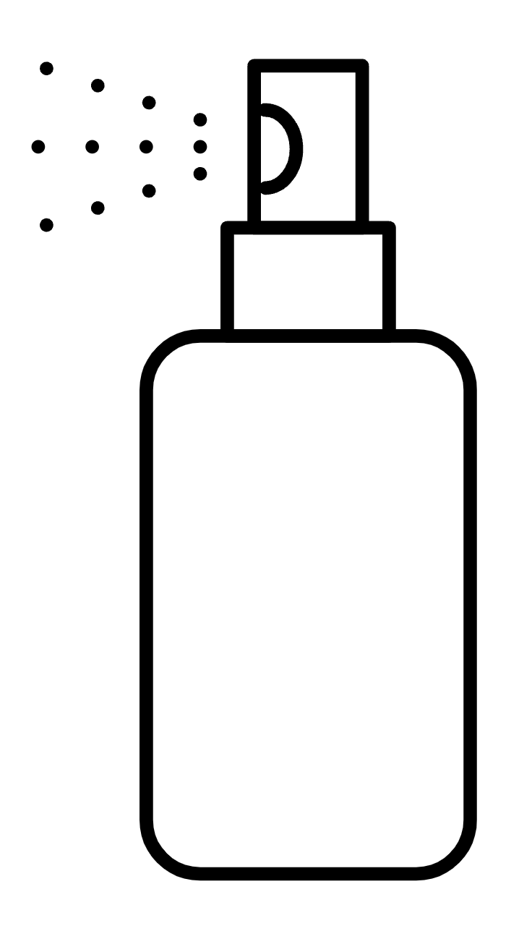
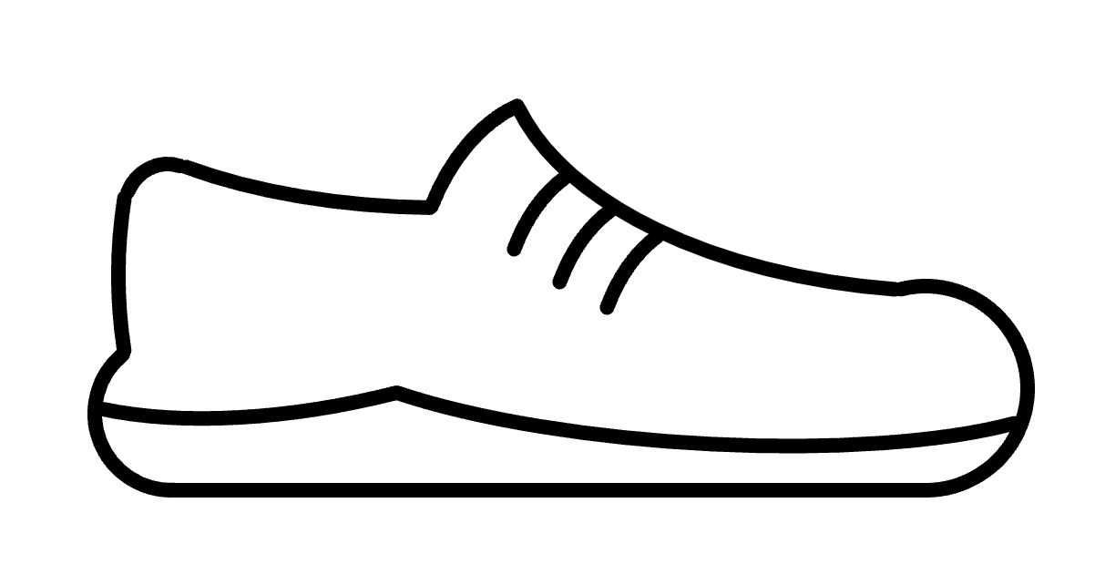
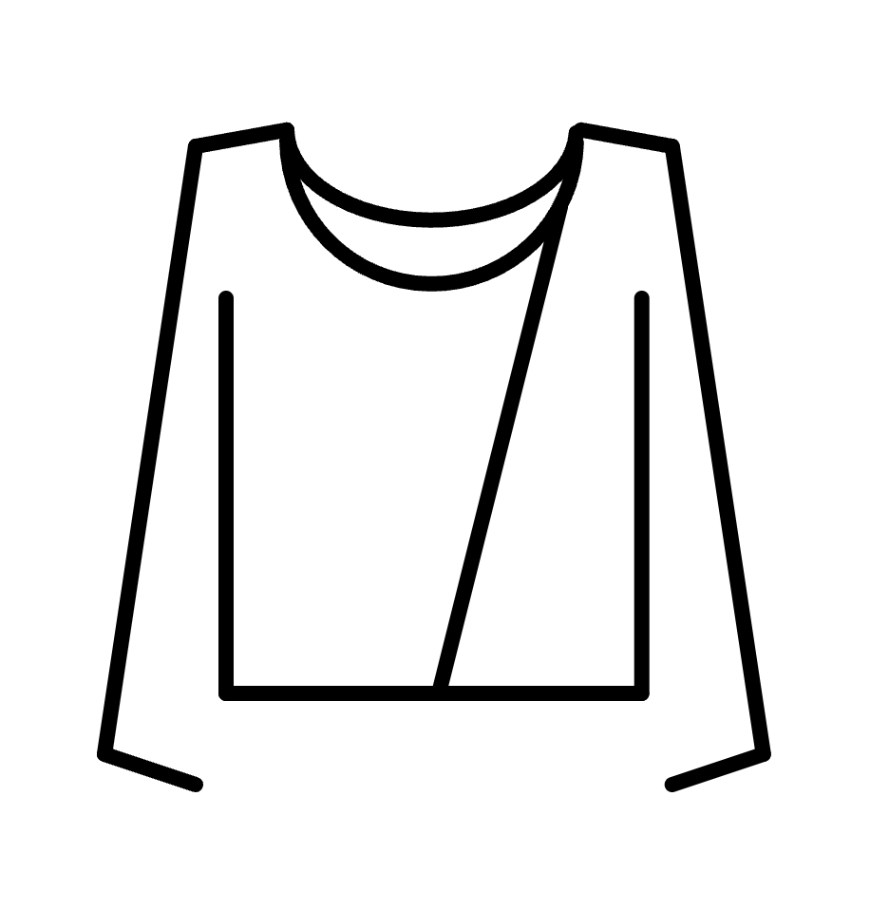
Most businesses find they are limited by design.
We should introduce refillable perfume bottles – but bringing consumers on board needs investment, and the payback period on that capital expenditure is too long.
senior executive,
major beauty brand
I’ve been asked to create
a range of regenerative clothing – while being expected to deliver the usual 15% profit margins from the outset. Impossible.
We prototyped an expandable shoe – it was going to be profitable, but wouldn’t have hit our usual margins, so we dropped it.
head of innovation,
major clothing brand
ex-senior executive,
major footwear brand
‹#›
Notes:
What does this look like in practice? Here are examples of businesses being held back from pursuing transformative ideas.
We met a former senior executive from a major footwear brand. He told us the story of how they designed a lower-priced shoe that would be affordable for millions of children who currently lack good quality footwear. The shoe would also be more durable, as it could be expanded as the child’s foot grew, avoiding the need to replace it regularly. This shoe would be both ecologically beneficial and socially beneficial. It would be profitable for the company, providing a margin for the business and allowing them to reach new customers around the world who normally could not afford their products. When the idea was pitched within the company, however, it was declined as it didn’t meet the standard high margin requirements of the business.
Similarly, we met senior executives in a beauty company that told us how they were unable to unlock the needed investment to move towards refillable perfume bottles – the single most important way for them to meet their net zero carbon commitments. And executives in fashion that faced inflexible margin expectations in attempting to move to regenerative clothing.
These are some of the ways that the deep design of a business holds back transformative ideas.

Slide 10
Degenerative
Divisive
Regenerative
Distributive
Business
as usual
designed to maximise margins and dividends
Commons & communities
Public services
NGOs & charities
What’s possible with current business design
‹#›
Notes:
But are businesses designed to pursue these ideas? If we look at organisations outside the business world, we discover they are typically not fundamentally held back by their design. But businesses are designed to only pursue transformative ideas if it also maximises profits.

Slide 11
Degenerative
Divisive
Regenerative
Distributive
Business
as usual
designed to maximise margins and dividends
Business redesigned to unlock regenerative & distributive possibilities
Commons & communities
Public services
NGOs & charities
‹#›
Notes:
So let’s redesign business to unlock these ideas.

Slide 12
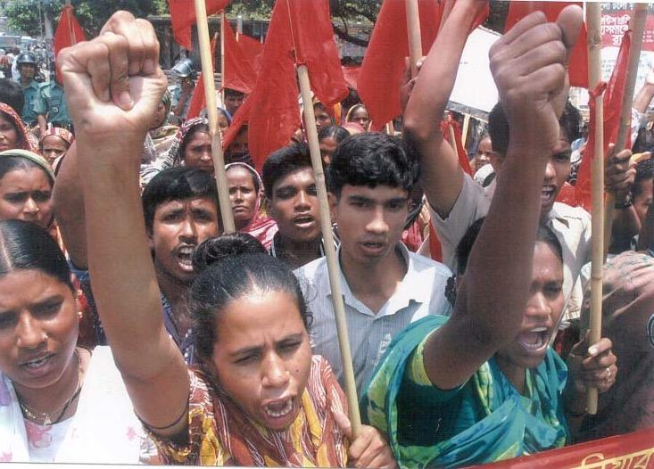
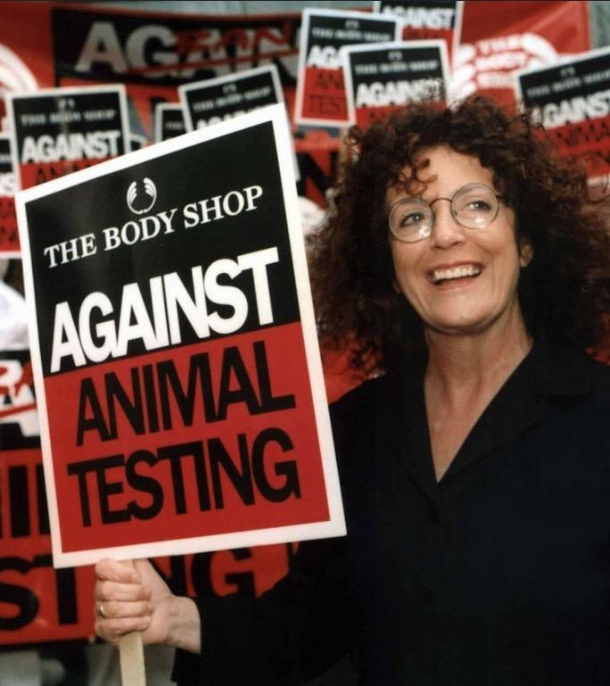
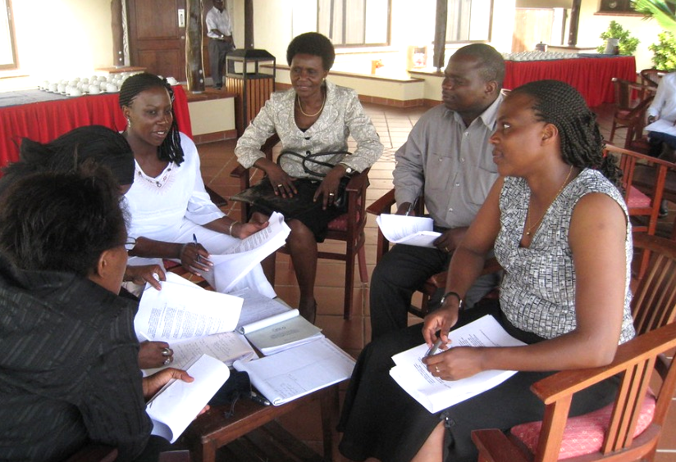
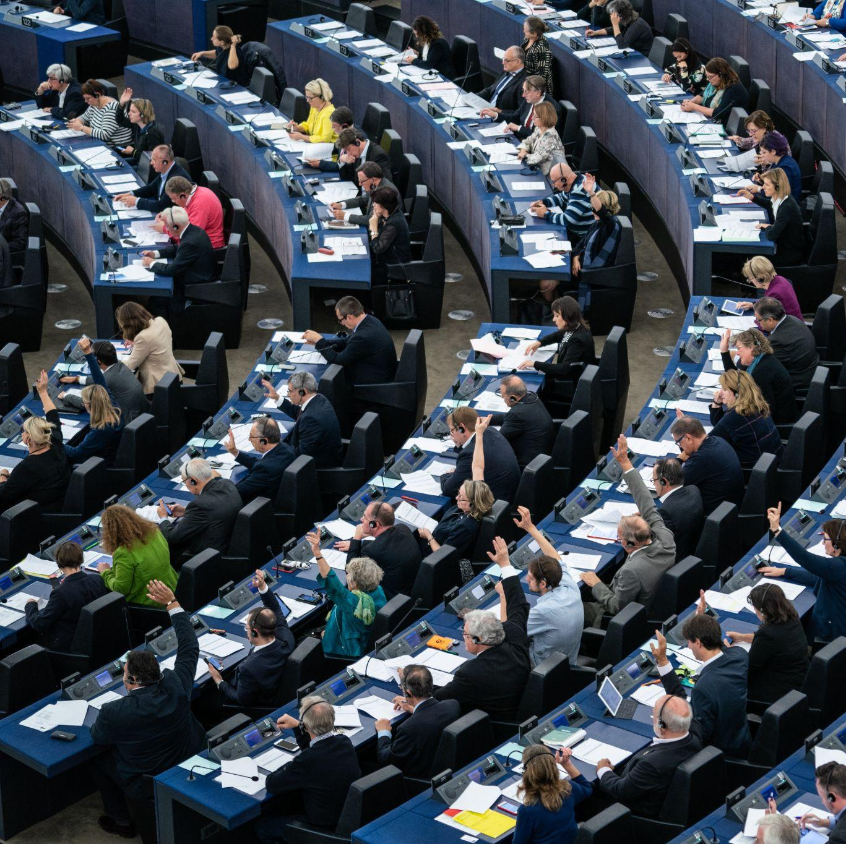
There are many effective ways to start transforming business.
Exerting public pressure
Providing enlightened leadership
Setting new targets and metrics
Making the business case
To reinforce these and drive further ambition, Doughnut Economics focuses on transforming the deep design of business.
‹#›
Notes:
We need to recognise the many ways business can be transformed to pursue such ideas. To reinforce these and drive further ambition, Doughnut Economics focuses on transforming the deep design of business.

Slide 13
This is the deep design of business - as inspired by author & theorist Marjorie Kelly.
Degenerative
and divisive
Regenerative and distributive
How much value can we extract through this enterprise?
Purpose
How many benefits can we generate through this enterprise?
Networks
Governance
Ownership
Finance
‹#›
Notes:
This means a journey from the outdated question that underpins the design of businesses: ‘How much value…’ to the new 21st century question that must underpin the design of businesses: ‘How many benefits can we…’
To explore enterprise design and generate new ways to design businesses, we drew upon the work of author & theorist Marjory Kelly. To dive into the design of businesses, we propose 5 layers of enterprise design.

Slide 14
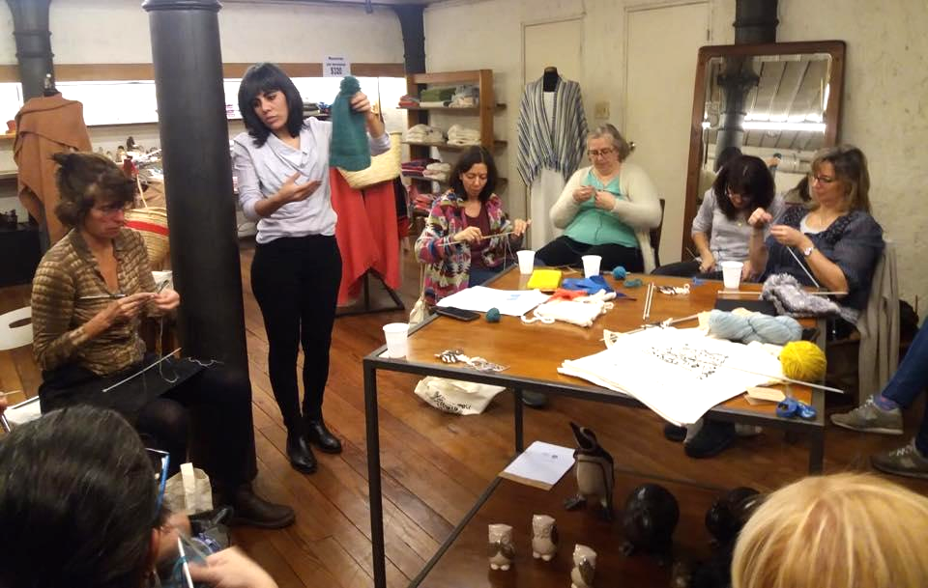
Purpose
Why does this business even exist?
What purpose does it serve in the world?
How is that purpose manifest in its operations?
How is that purpose manifest in its products or services?
Degenerative
and divisive
Regenerative and distributive
Profit driven business
Purpose driven business
Purpose
Networks
Governance
Ownership
Example Manos del Uruguay
Finance
‹#›
Notes:
Let’s begin with Purpose and think about the fashion industry. Is the purpose to produce as much as possible, as quick as possible for as cheap as possible – as in the case of fast fashion? Or is to create high quality garments from natural fibres and distribute the value to those who make the garments – as in the case of Manos del Uruguay, owned by women artisans spread across Uruguay?
Here we ask, why does the business exist and how is its purpose embedded in its operations, products and services? Is it willing to transform these in pursuit of its purpose?

Slide 15
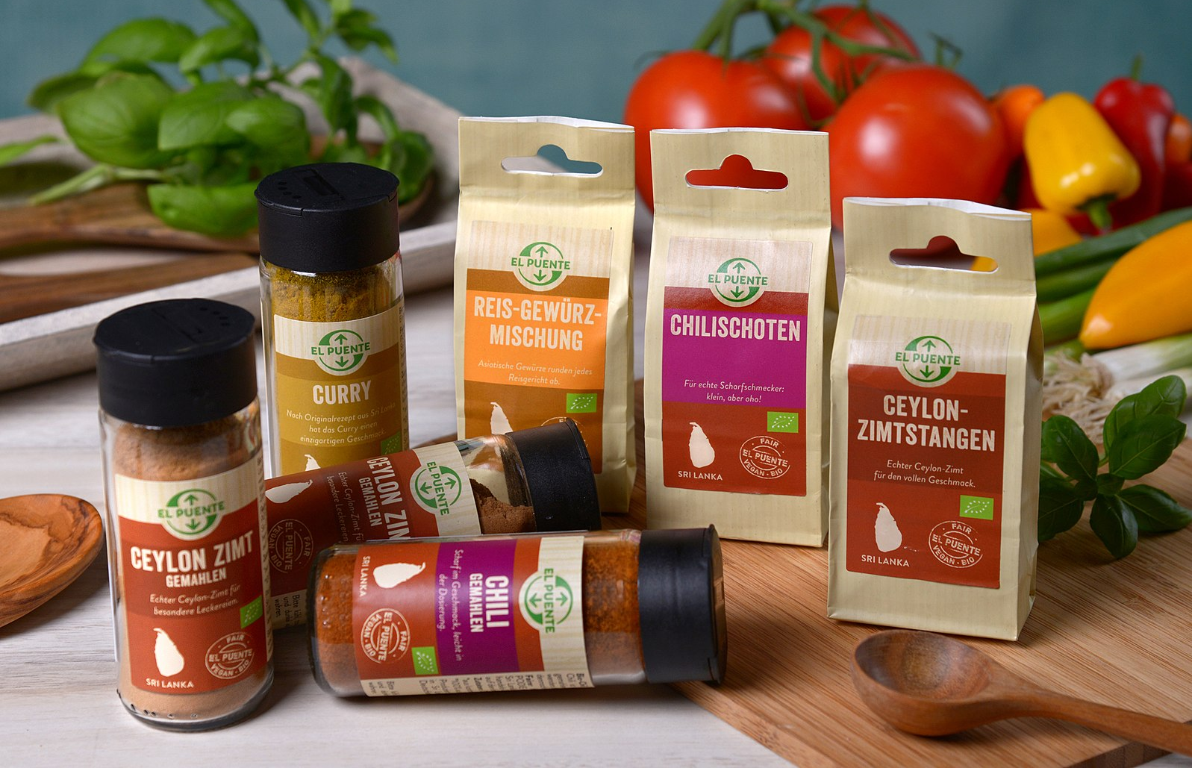
Networks
What relationships does the business hold - with its customers, suppliers, staff, governments, communities and partners?
What new connections does it need to create?
What outdated relationships must now be left behind?
Degenerative
and divisive
Regenerative and distributive
Extractive relationships
Collaborative partnerships
Commodified relationships
Purpose
Tax avoidance
Networks
Regressive lobby groups
Governance
Ownership
Example El Puente
Finance
‹#›
Notes:
Then we move to Networks, which is all about the nature of the relationships with customers, suppliers, staff, communities, partners… Are its supply chains made up of commodified relationships, where there is no commitment to suppliers? Or does it make long-term commitments to suppliers, support them with orders and financial flexibility even during crises, like the German brand and distributor El Puente, which gives a board seat and co-ownership to its suppliers.
When exploring the design of a business, we also ask about the relationship with governments – is it trying to avoid tax and lobby against regulations and progressive action? Or is it paying a Fair Tax and joining business networks advocating for ambitious government action on ecological and social issues?

Slide 16
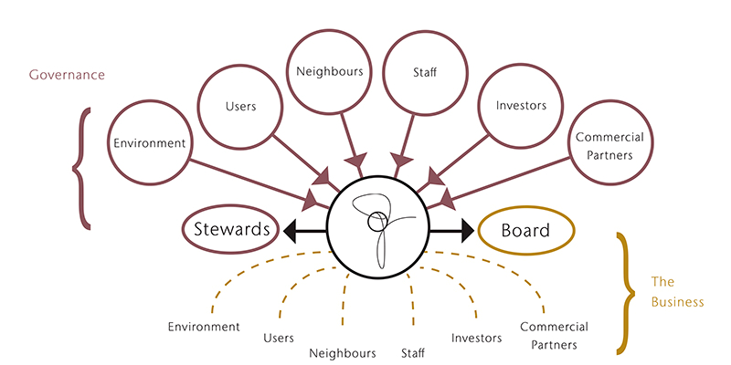
Governance
Who is on the board, with a voice in decision-making?
What are the company rules and culture?
What are the metrics of success?
How openly are annual accounts reported?
Degenerative
and divisive
Regenerative and distributive
Governance in service of finance
Governance in service of purpose
Purpose
Networks
Governance
Ownership
Example Riversimple
Finance
‹#›
Notes:
Next is Governance. To evaluate the design of the governance of businesses, we ask questions like:
Which stakeholders are represented on the board, and which should be? How do decision-making processes navigate trade-offs between social, ecological and financial goals, and how transparent is the business.
Think here about the governance and specifically board model of Riversimple, a hydrogen car company based in Wales. Its board has a Future Guardian Governance model that includes 6 custodians on the board of directors representing the interests and perspectives of stakeholders like the environment, customers, community, staff, investors and commercial partners. This fundamentally shapes how priorities are set and difficult decisions are navigated.
The design of the board, decision-making processes and metrics of success are all design choices that are made by every business.

Slide 17
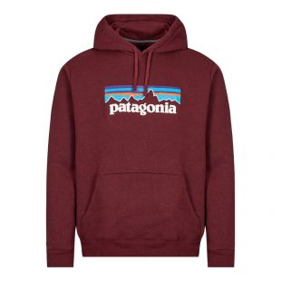
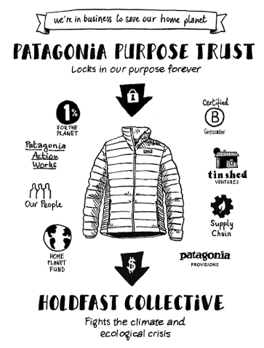
Ownership
Who owns the business?
What are their interests and expectations?
To what extent can the owners change or undermine the intended purpose of the business?
Degenerative
and divisive
Regenerative and distributive
Extractive ownership
Generative ownership
Venture capital
Purpose
Stock market
Networks
Private equity
Governance
Ownership
Example Patagonia
Finance
‹#›
Notes:
The fourth design layer is Ownership. Here we look at:
Who owns the business, their commitment to the purpose, how long-term their ownership is for and to what extent the owners can change or undermine the purpose of the business?
We also look at the stakeholders who are represented in the ownership mix.
And we ask how the expectations of owners shape decisions – for instance on ecological, social and financial performance?
Think here about the example of Patagonia, which has proclaimed that Earth is its only shareholder. Patagonia deployed a Steward Ownership model to create two classes of shares in its ownership redesign.
• One share class holds all the dividend-rights, but none of the voting rights. While getting the profits, this redesign means this share class cannot pressure Patagonia to increase its profits.
• The second share class gets all the voting-rights but none of the dividends. This share class, which is the Patagonia Purpose Trust, is not focused on increasing profits, meaning it can truly be a steward of Patagonia’s social and ecological purpose and use the power of its voting shares accordingly.
In essence, through the Steward Ownership model, Patagonia separated power and money in its ownership model. If you’re a decision-maker within Patagonia after this ownership redesign, it is now even clearer that the priority is the purpose, and there is no pressure to keep growing profits. This can unlock a new level of ambition and possibilities.
There are many other emerging possibilities in ownership design that are being pioneered around the world, from platform coops to employee ownership, from community owned businesses to a broad range of hybrids and multi-stakeholder models. Redesigning ownership in these ways is absolutely pivotal.

Slide 18
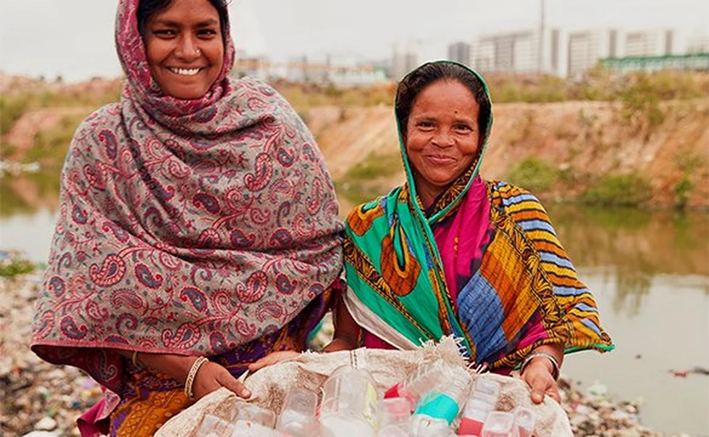
Finance
Where does finance come from, and what does it demand?
What are the margin and dividend expectations?
What are the rules on reinvestment & profit allocation?
What’s considered a fair return for investors?
Degenerative
and divisive
Regenerative and distributive
Finance serving financial returns
Finance serving purpose
Purpose
Networks
Governance
Ownership
Example The Body Shop and Plastics for Change partnership
Finance
‹#›
Notes:
The final design layer is finance. Looking at business through the perspective of Doughnut Economics poses questions like:
• What does the finance behind the business expect and demand?
• Do margin requirements adapt to enable transformative ideas?
• Is reinvestment enabled through mechanisms like, for instance, a cap on dividends?
• And whether investors receive a fair return, but the priority is for finance to serve purpose?
As we showed through our examples in shoes, beauty products and fashion, financial parameters can either block or enable transformative ideas.
Think of the partnership between the Body Shop and the social enterprise Plastics for Change. The partnership created the world’s first large-scale Fair Trade recycled plastic, achieving improved and more stable livelihoods for waste-pickers in India who collect plastic waste. To make the partnership work, the financial parameters were adapted to consider broader perceptions of value, going beyond a focus on immediate financial value. The willingness to go beyond margins and costs unlocked the needed commitment and investment from the Body Shop to make this partnership work.
Shaping the financial parameters within businesses is a critical design choice for businesses hoping to be regenerative and distributive by design.

Slide 19
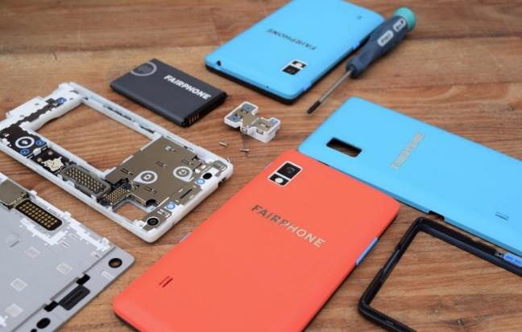
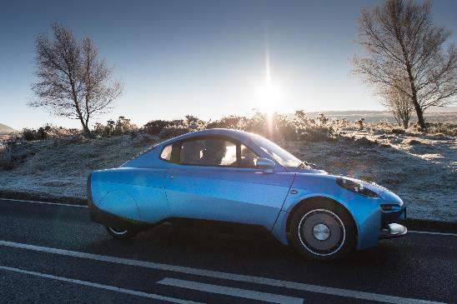
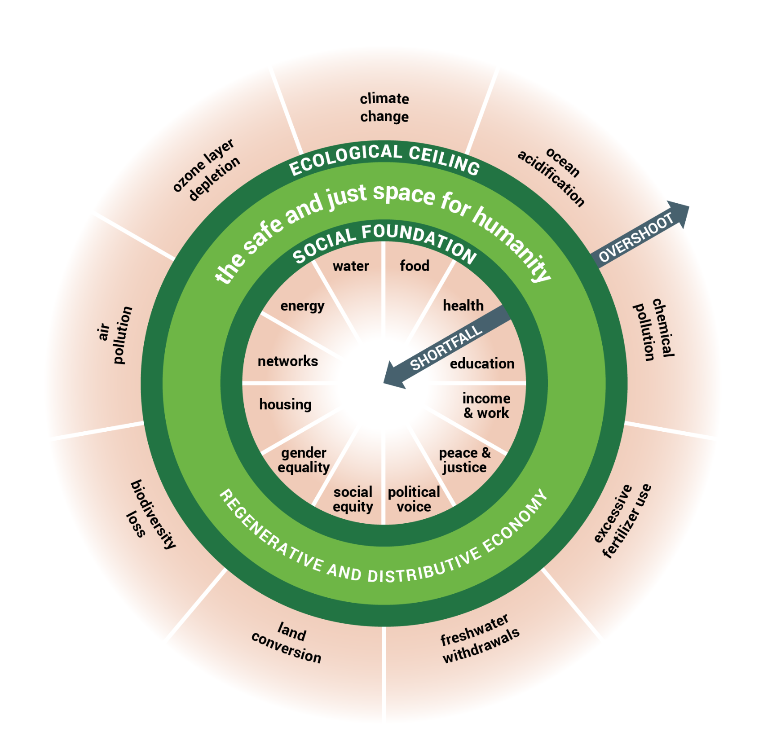
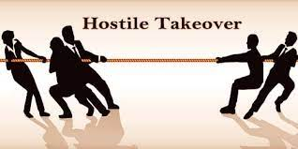
Benefits of redesign
Product design process
Purpose
aligning internal processes with business purpose
enabling new partnerships and engaging stakeholders
channelling investment into transformative ideas
locking-in legacy and protecting mission
becoming regenerative and distributive by design
Networks
Supply chain security
Governance
Ownership
Fresh innovations
Finance
Protect mission / legacy
‹#›

Slide 20
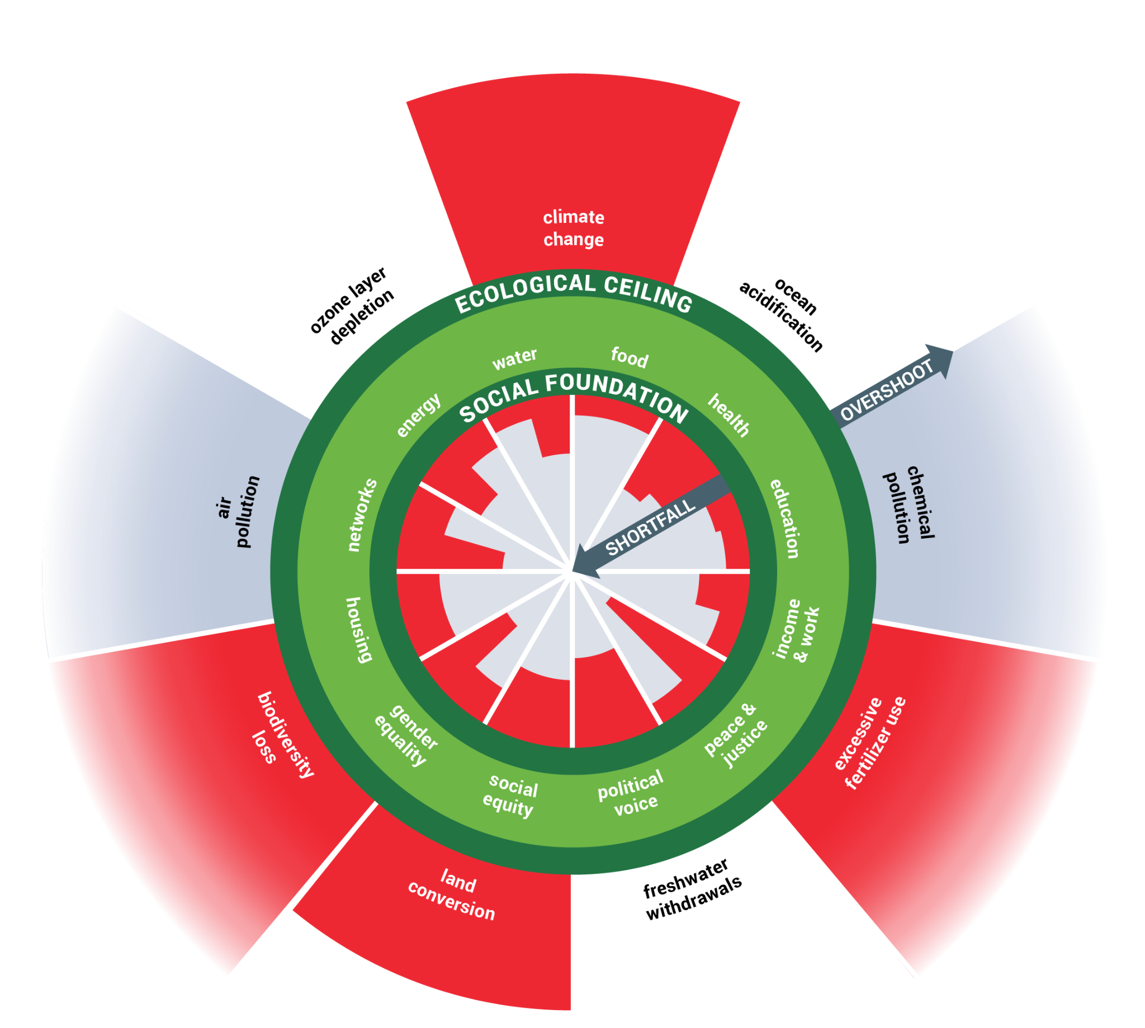
Doughnut Design for Business
How does the design of your
business block transformative action?
How could a redesign of your business unlock transformative action?
Purpose
Networks
DEAL’s guide to redesigning businesses through Doughnut Economics
- Core workshop
Governance
Ownership
Finance
doughnuteconomics.org/tools/191
Notes:
How does it trap you in degen & distrib
…

