Slide 1
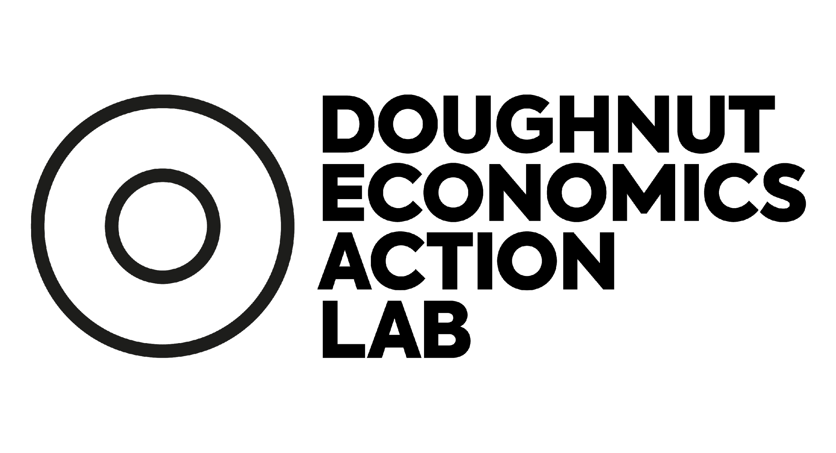
Doughnut Economics
turning ideas into action
An introduction to the work of local and regional governments
Leonora Grcheva
September 2023

Slide 2
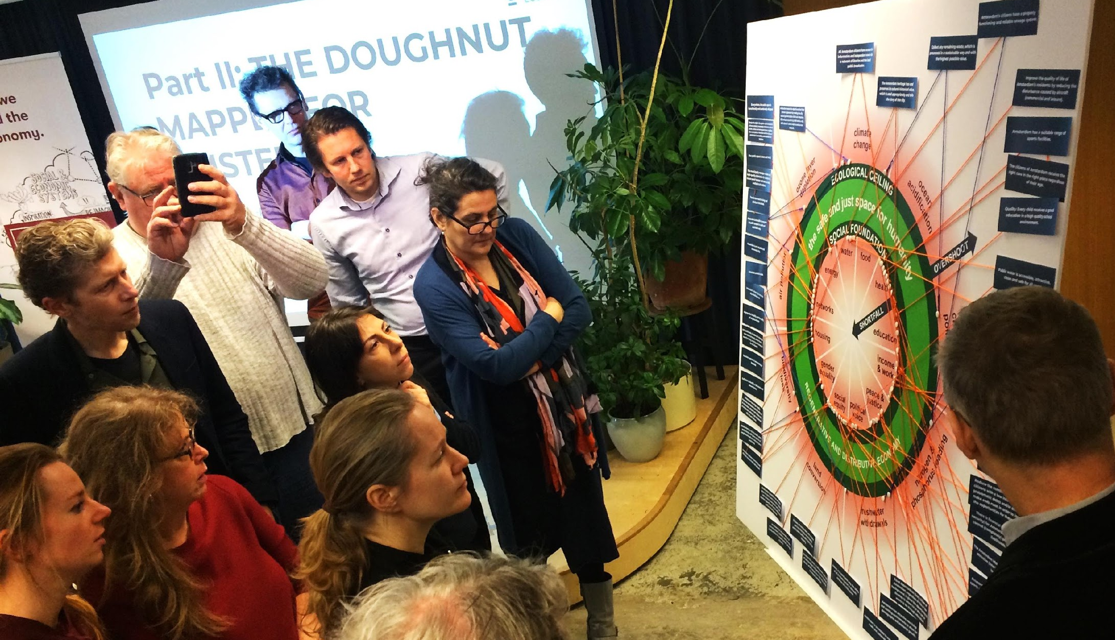
The beginnings of cities working with Doughnut Economics
Workshops in Portland, Amsterdam and Philadelphia
Notes:
The work of cities with DE started in 2019, when DEAL, collaborating with C40, Circle Economy and Biomimicry 3.8 ran workshops with city officials in all three places and began exploring what it means to downscale the Doughnut to the scale of cities, regions, neighbourhoods. Out of that process, the Doughnut Unrolled methodology was developed (initially called Creating City Portraits), and Amsterdam became the first city to have a City Portrait based on DE, which then underpinned the city’s Circular Economy Strategy.

Slide 3
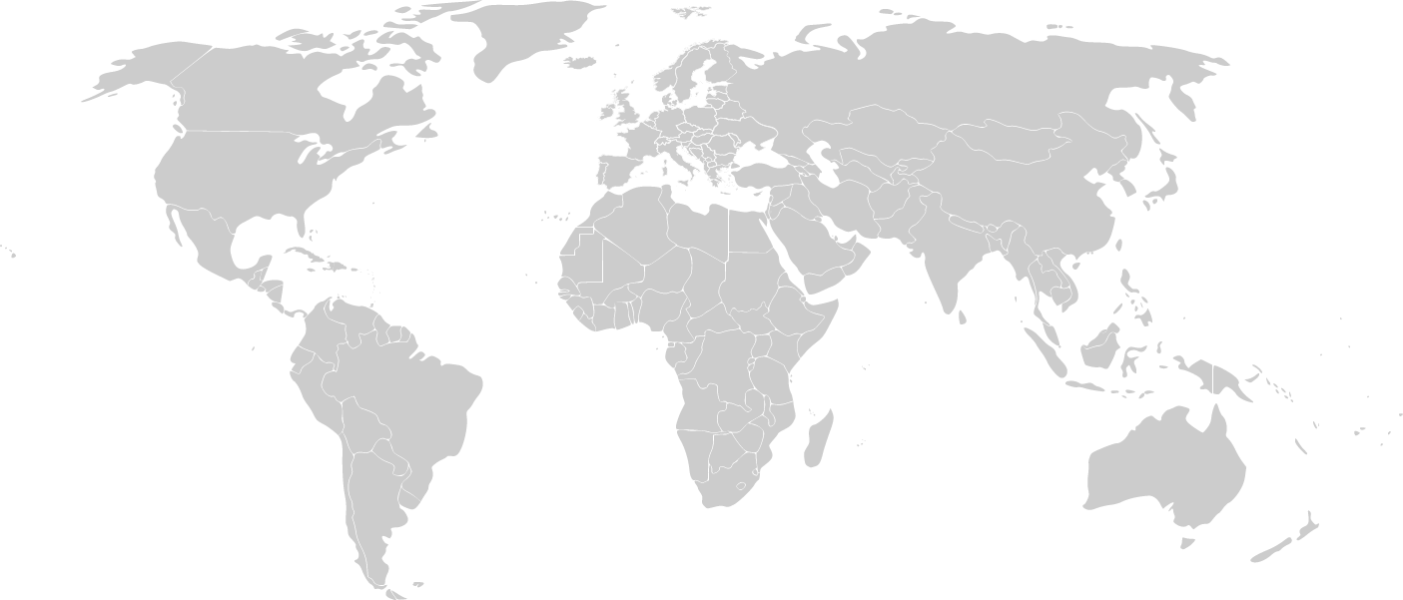
Cities and regions engaging with the Doughnut, 2023
Kalix
Cambridge
Aberdeenshire
Vadstena
Glasgow
Amsterdam
Tomelilla
Dublin
Pirkanmaa
Nanaimo
West Midlands
Copenhagen
Jyväskylä
Portland
Brecon Beacons Nat. Park
Bad Nauheim
Philadelphia
Cornwall
Yerevan
Valence-Romans
Brussels
Grenoble
Thimphu
Mexico City
Curaçao
Barcelona
Ipoh
Cali
El Monte
Wellington
Dunedin
‹#›
Notes:
The work of Amsterdam was widely published by the media and largely inspired the first wave of local governments picking up Doughnut Economics. Ever since, over 80 local and regional governments in the world have started internally exploring the concepts and what would it mean for their place to put them into practice, and around 30 (to count) have officially brought in DE into adopted policies in various ways. (in the image the named cities have in some public capacity officially engaged with DE, while the green dots mark additional places that have been internally exploring the concepts).

Slide 4
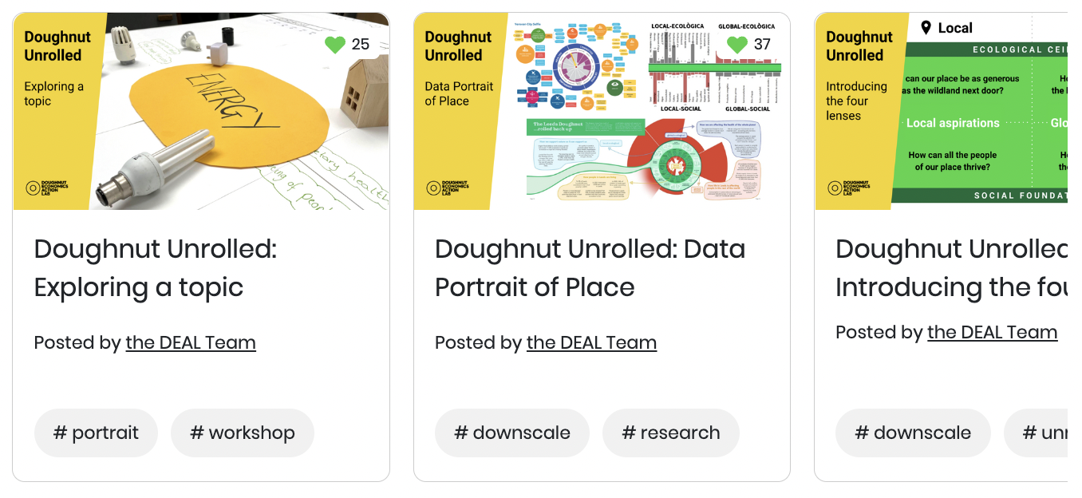
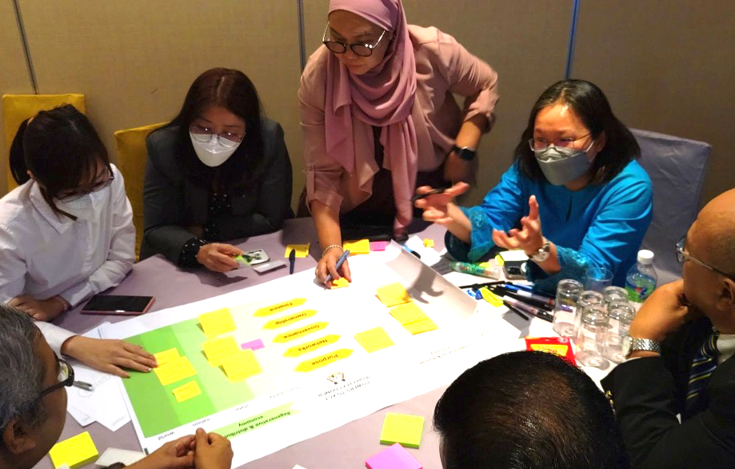
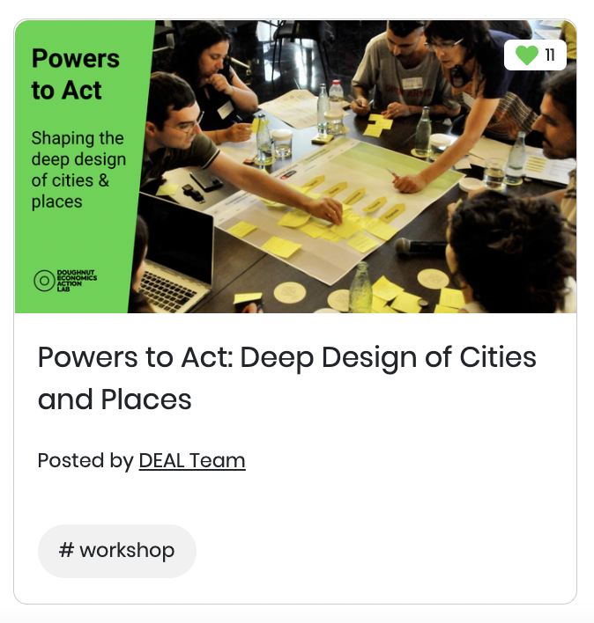
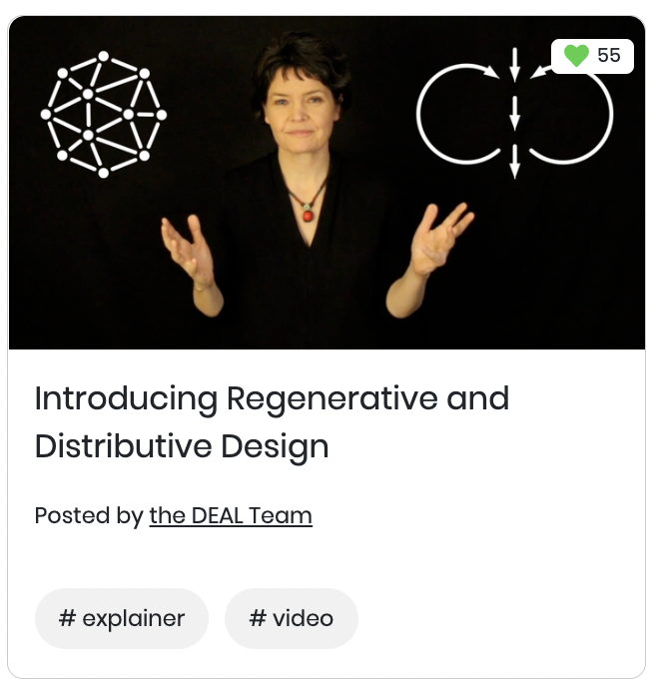
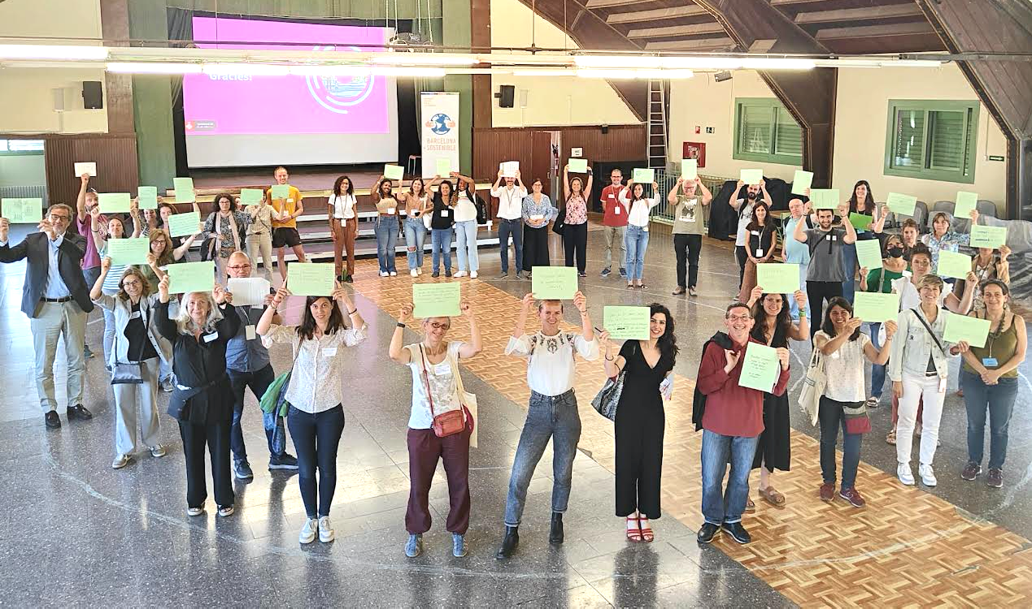
Learning from the evolving experience of cities
DEAL’s tools
Cities learning in action
Notes:
We at DEAL have been developing tools and methodologies, and in parallel, cities have been experimenting - sometimes with our tools as a starting point, and sometimes innovating their own starting points. From this emerging practice, learning with and from cities, we continue to evolve the answer to the question, what does it mean for a place to engage with Doughnut Economics.

Slide 5
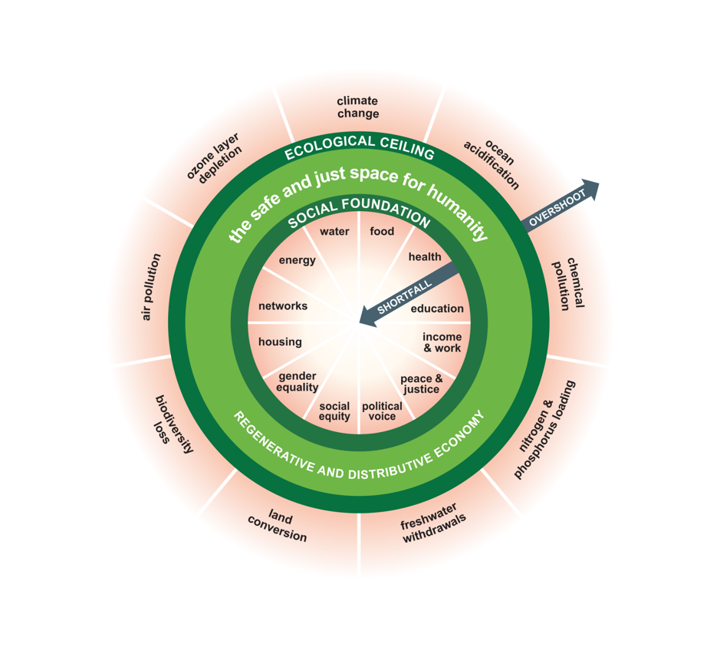
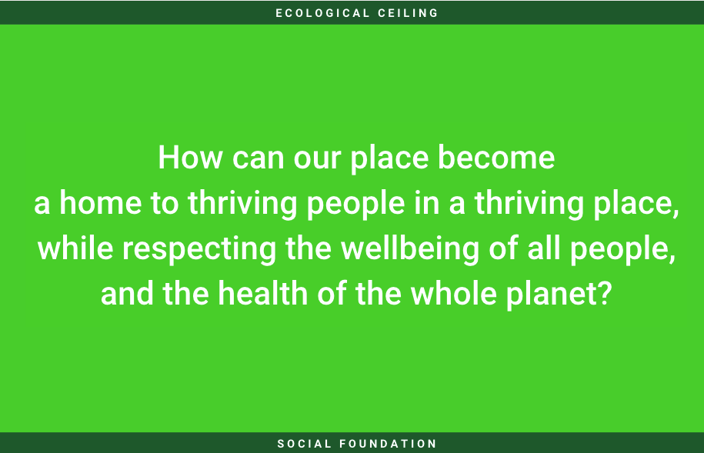
Cities & regions aiming for the Doughnut - what does it mean?
region
city
borough
city
region
municipality
neighbourhood
city
Notes:
So - let’s start from the very core question - what does it mean for a local government to engage with Doughnut Economics? This is actually not a simple question with a simple answer, but a very alive one for us, the way we see it, the answer to this is being co-created through the work of experiences of all of you, complementing the theoretical and core concepts of Doughnut Economics. So, this is how we see it now. Engaging with the Doughnut Economics in its deepest sense means setting that long-term goal to help move your place in the safe and just space of the Doughnut Unrolled - becoming a thriving place for thriving people, while respecting the wellbeing of all people and the health of the whole planet. This is the compass - showing us where we’re headed towards.

Slide 6
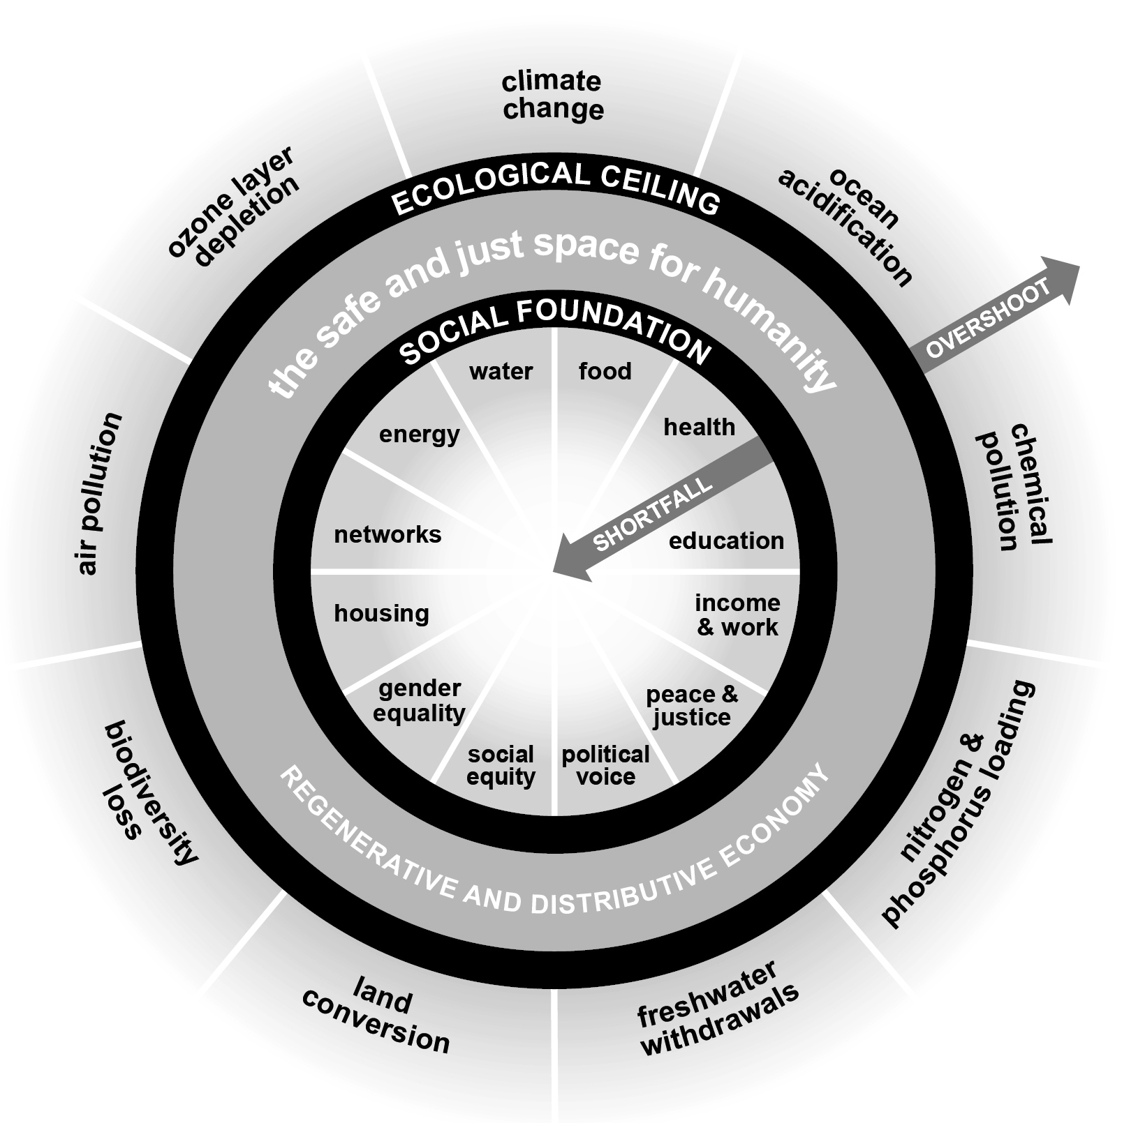
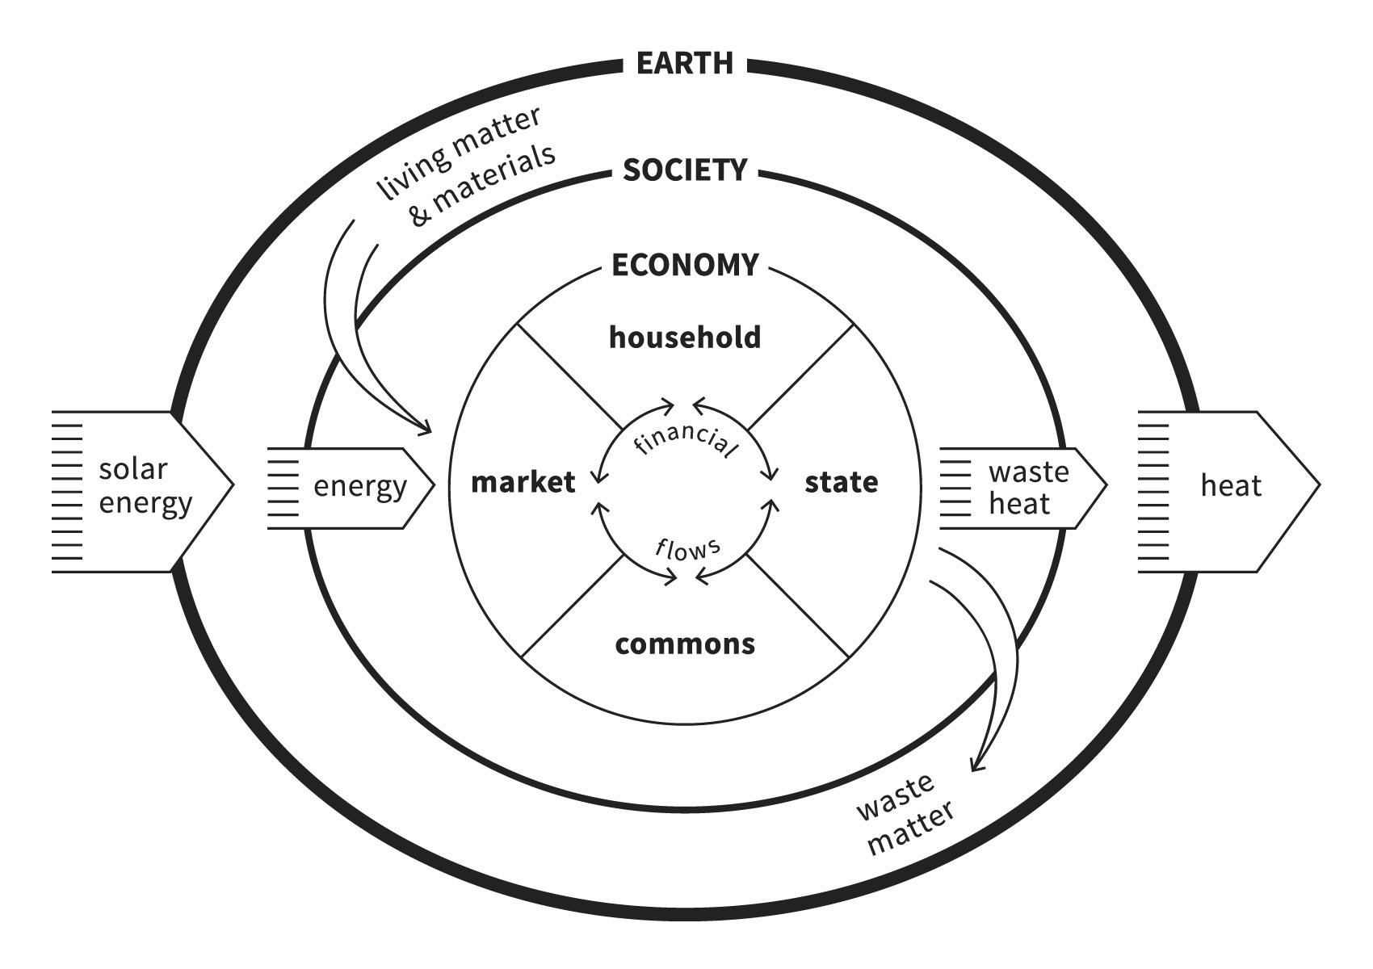
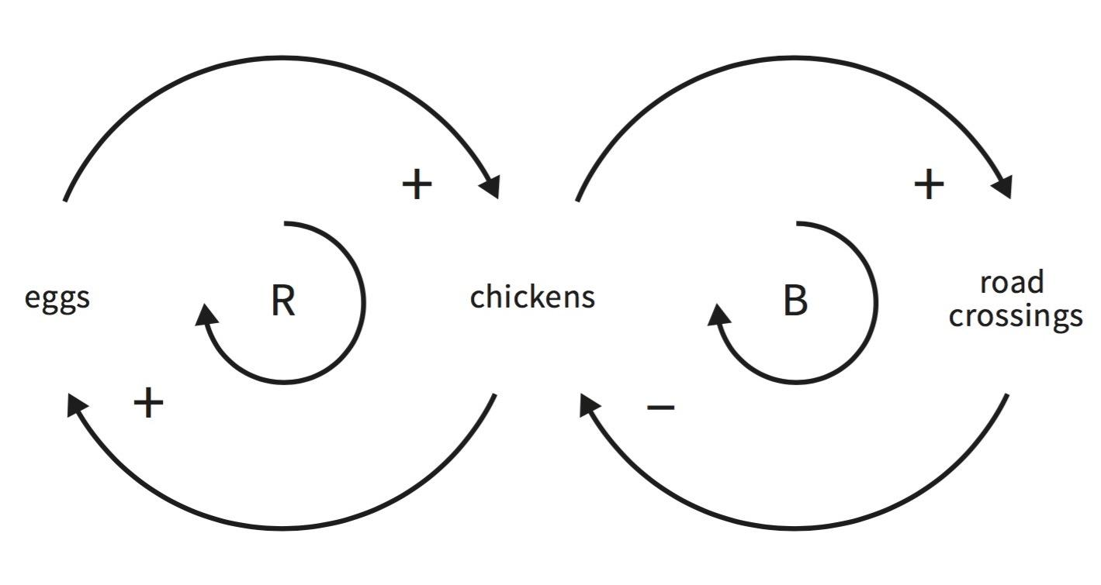
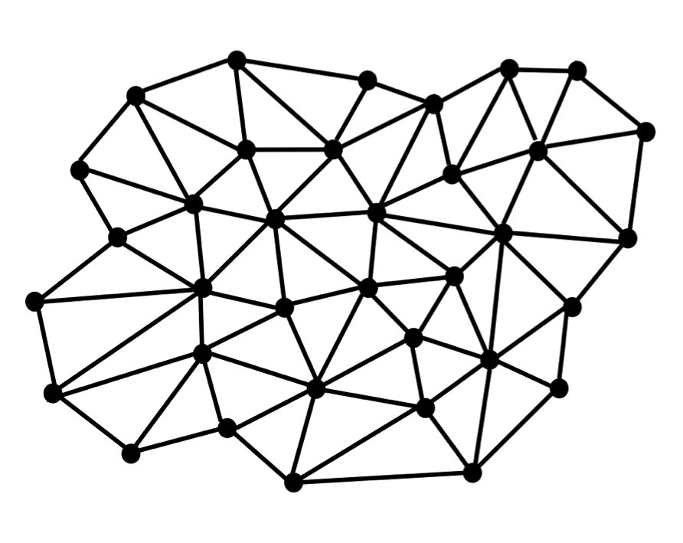
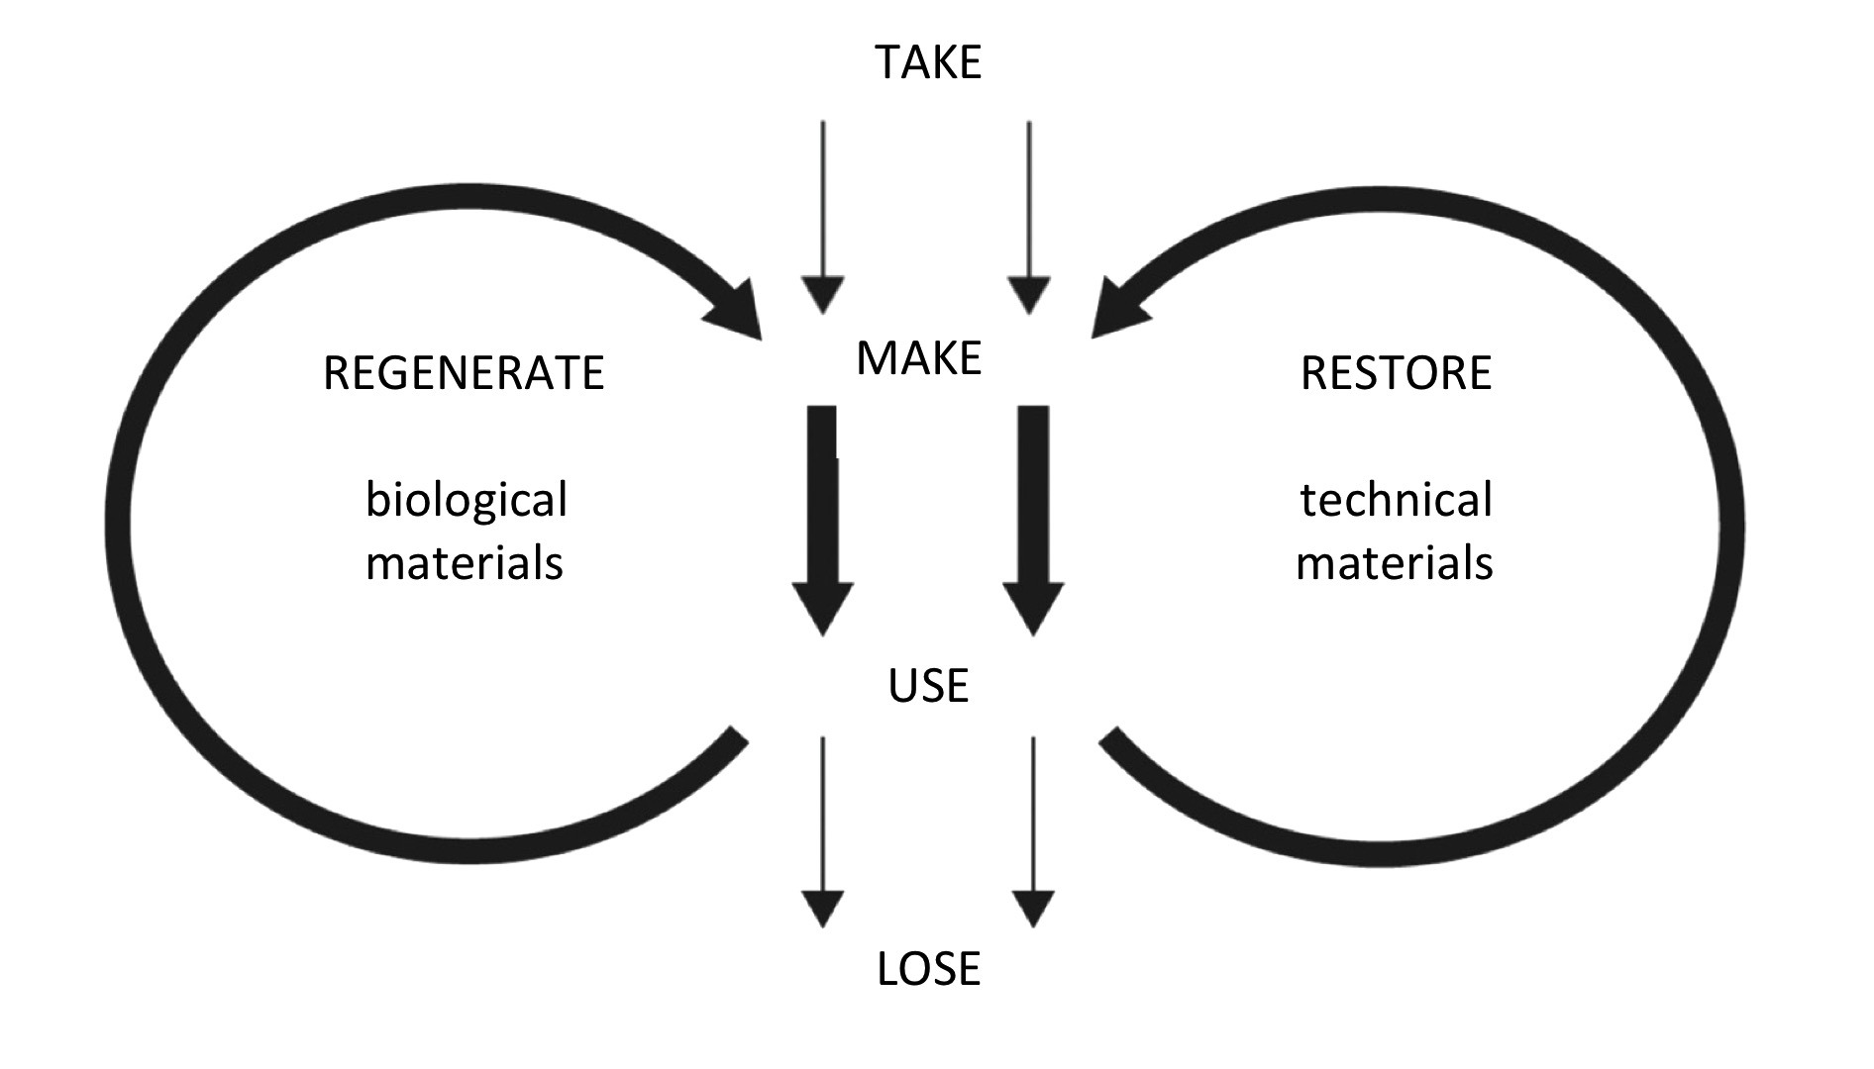
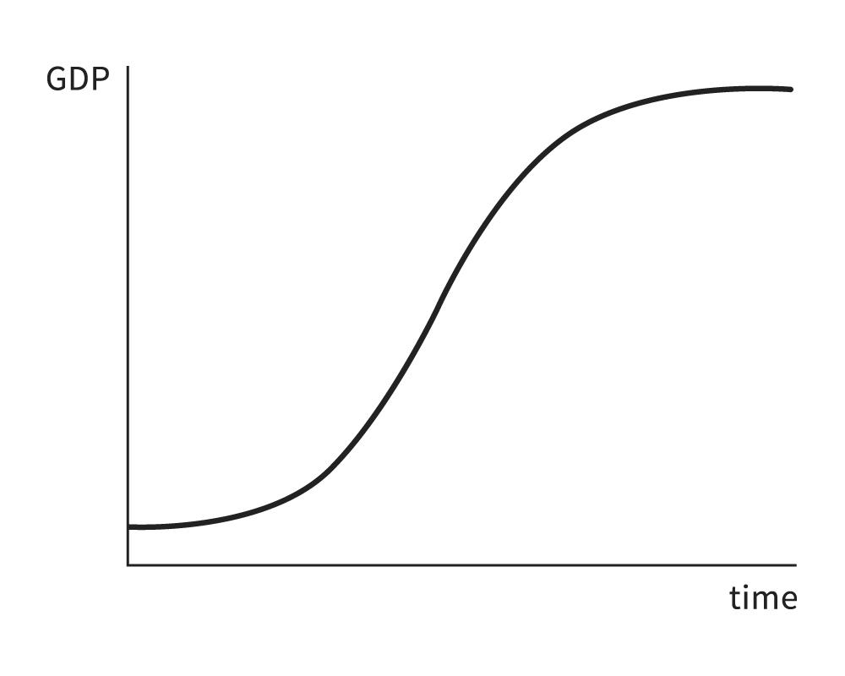
Cities & regions aiming for the Doughnut - what does it mean?
1. Change the goal
2. See the big economic picture
3. Nurture human nature
4. Get savvy with systems
5. Be distributive by design
6. Be regenerative by design
7. Think again about growth
Notes:
And the seven principles are showing us the transformative change needed to be moving in that direction - the process change, organisational change, mindset and culture shift we need - so we design policies bringing the whole economy into account, not just the state/city and the market, but also the household and the commons, so we can nurture human nature and anchor our policy and service design into solidarity and participatory democracy, moving out of siloed working and one-fit-for-all solutions towards breaking sectoral boundaries, working and thinking in systems fit to the complexity of real life (designing new models of governance, decision making and finance), so we design policies and practicies that are regenerative and distributive by design, actively restoring nature and distributing value rather than aiming for no harm done, and help shift our economies to be regenerative and distributive by design. And thinking again about growth and the long-terms goals and mission we set for local governments - so that they actually serve the wellbeing of people and planet.

Slide 7
The complex reality of cities and regions
region
city
experiment
jurisdiction
uncertainty
city
borough
budget cycles
political will
finance cuts
region
municipality
complexity
national policy
disruptions
neighbourhood
city
Notes:
But, we must recognise that local governments, often huge organisations, complex, consistent of many departments, working with many stakeholders, bounded in many local and national policies, budgets, reporting mechanisms, political cycles, local governments get started in different ways - sometimes starting small, sometimes big, sometimes in many different ways at once. But every place can start the transformation somewhere.

Slide 8
Why cities engage with the Doughnut
Gives tools and pathways for setting new transformative agenda in age of crisis
A holistic framework that unites different interests and players (social vs ecological, local governments vs civil sector)
Strong visualisation has powerful mobilising impact, and helps communicate and tackle complex issues
Offers new ways to measure progress
A narrative of hope and optimism, where everyone has a role, resonates with many and appeals widely
Notes:
Before getting into the ‘how’, we’ll briefly look at the ‘why’ - learning from cities - have they been bringing DE into their work. There are several main reasons:

Slide 9
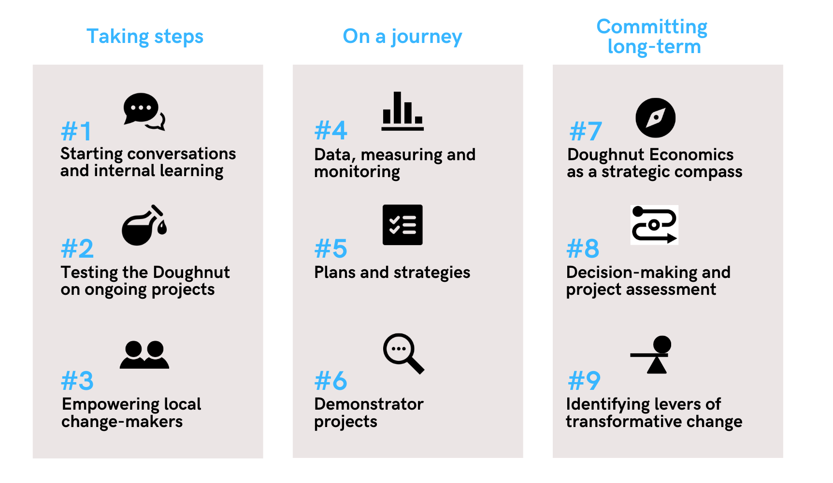
How cities engage with the Doughnut: 9 ways to get started
Notes:
So drawing from the evolving practice - we’re now seeing 9 ways in which local and regional governments are getting started with Doughnut Economics, divided into 3 categories - from ‘taking steps’ through ‘on a journey’ to ‘long-term commitment’, and these are based on the resources, political will and commitment that a place is able to put into the work. Sometimes the transformation starts big, with a political leader, mayor or council with a long-term vision, sometimes the change starts with an ambitious manager or junior officer who has an idea, whose work gradually can inspire others and spread throughout an organisation. The 9 ways are therefore not a step-by-step guide, but rather a library of options - allowing everyone, at any position of power and scope of influence to get started. And these 9 are not fixed in stone - they may become 12 or fully change in few years as we continue to learn through action, practice and experimentation.

Slide 10
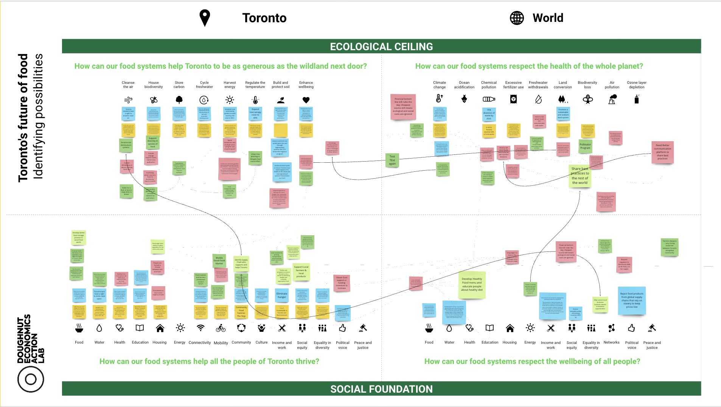
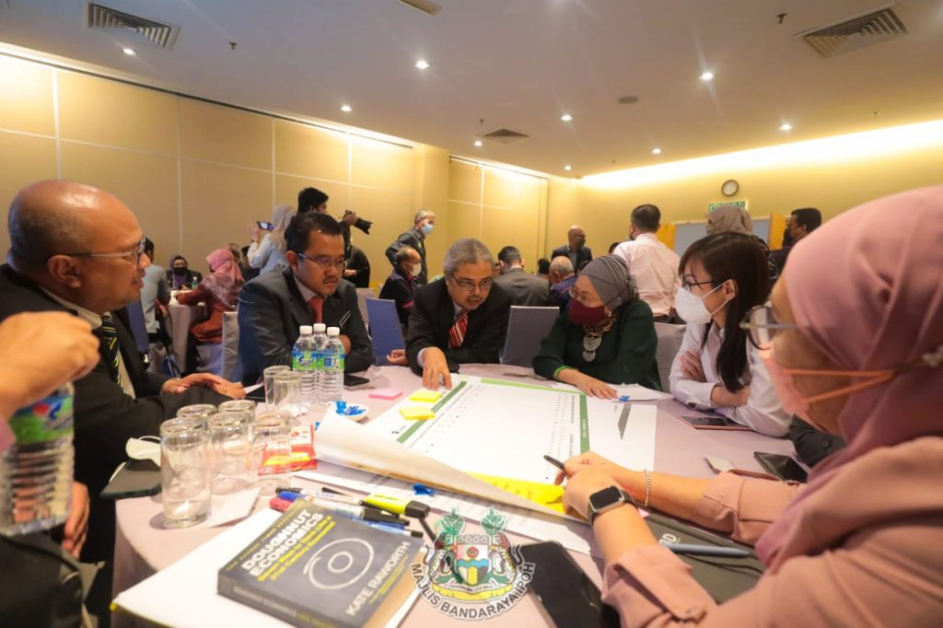
#1 Starting conversations and internal learning
Learning workshop in Toronto, Canada
DEAL’s learning exchange between cities
Workshop with city leaders, Ipoh, Malaysia
Notes:
One way to get started is through ‘internal conversations and learning’. Local and regional governments can learn and hold discussions about the concepts, tools, practical applications and possibilities of Doughnut Economics internally across leadership and departments. Learning could be done at the beginning of a local government’s journey, exploring how it relates to different areas of work and possibilities to move forward. Equally, it’s crucial to keep the learning going throughout and simultaneously with deeper work - as part of a continuous organisational change process. We’ve been learning from the practice of many - that socialising the concepts and how they apply to the work and practice of different departments crucial for ensuring longer term interest, success and buy-in. Places have been learning in many ways - attending events, visiting other places, reading DEAL’s stories, or with internal or partner champions / advocates holding workshops and discussions exploring the concepts and possible practice in depth.

Slide 11
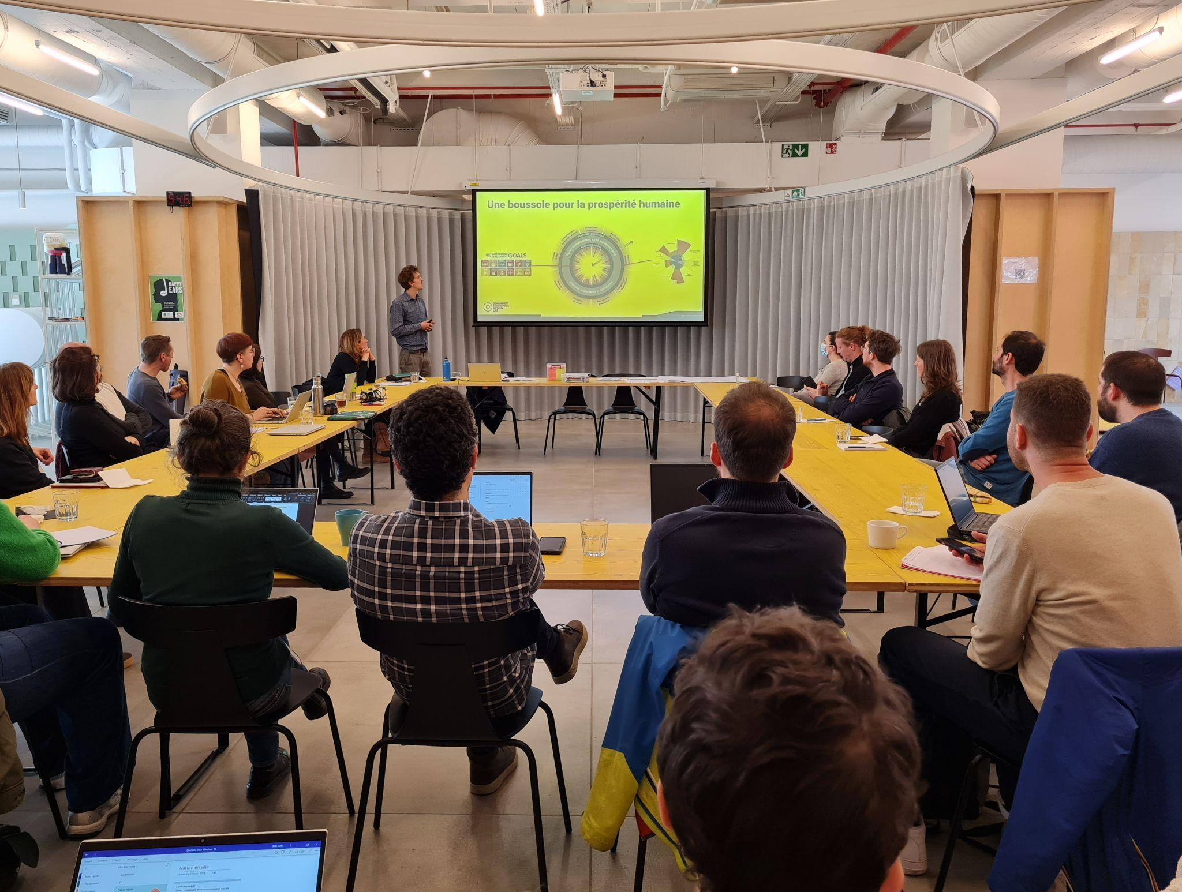
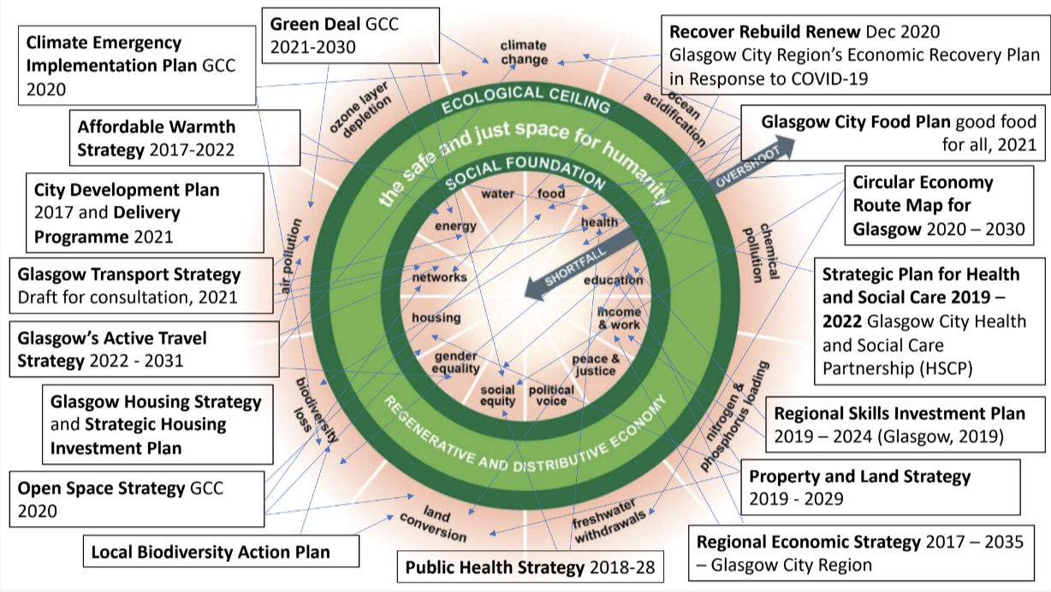
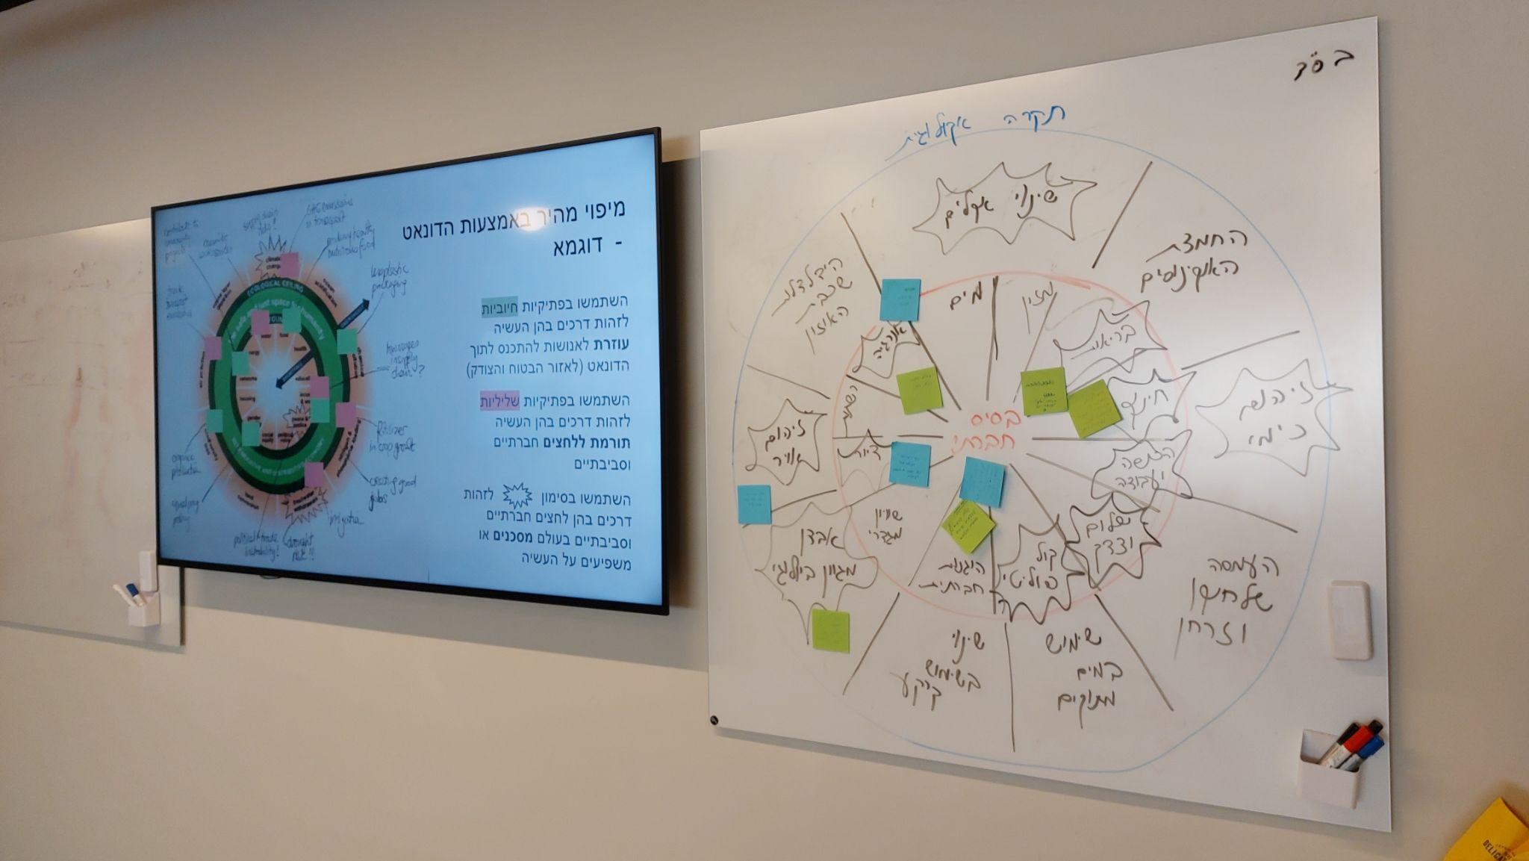
#2 Testing the Doughnut on ongoing projects
Mapping strategies, Barcelona, Spain
Workshop in Brussels, Belgium
Workshop in Tel Aviv-Yafo, Israel
Notes:
Testing the Doughnut on ongoing projects is about looking for strategic opportunities amongst already approved initiatives and resourced projects, to experiment and play with the worldview and tools of Doughnut Economics. This could entail anything from bringing in some tools into workshops, discussions and participatory processes, to trying out Doughnut Economics as a lens through which an ongoing project can be reviewed. So, this approach is often about exploring the potential value and applicability of DE tools and concepts ahead of any longer-term commitments, without long decision-making processes or the need for additional resources…and about developing a practical understanding of what the value could be. In Barcelona they did a mapping exercise mapping all the plans and strategies already in place against the social and ecological dimensions of the Doughnut, helping to identify interconnections and gaps. In Tel-Aviv-Yafo, the DE coalition facilitated a workshop for the Environment and Sustainability Authority exploring and assessing different ongoing projects through the Doughnut. In Brussels, the Brussels Donut team has been leading workshops and co-nequiries with a number of public agencies as well as built environment projects, helping project leaders over a series of workshops to understand how they are already contributing to a Doughnut economy, how they can be even more ambitious.

Slide 12
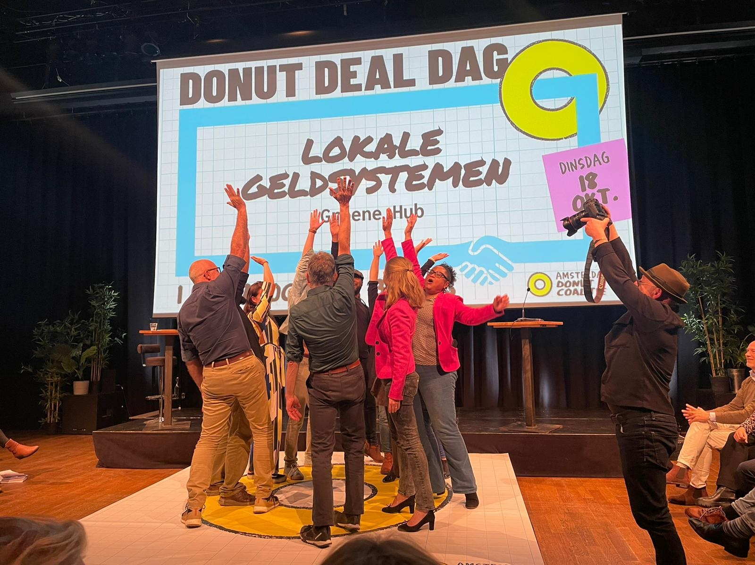
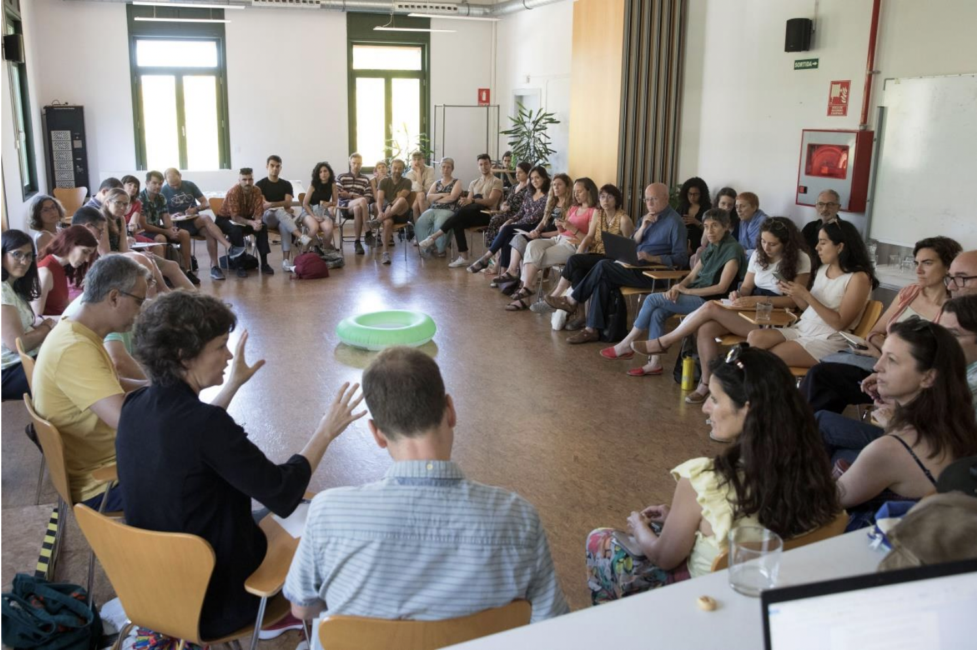
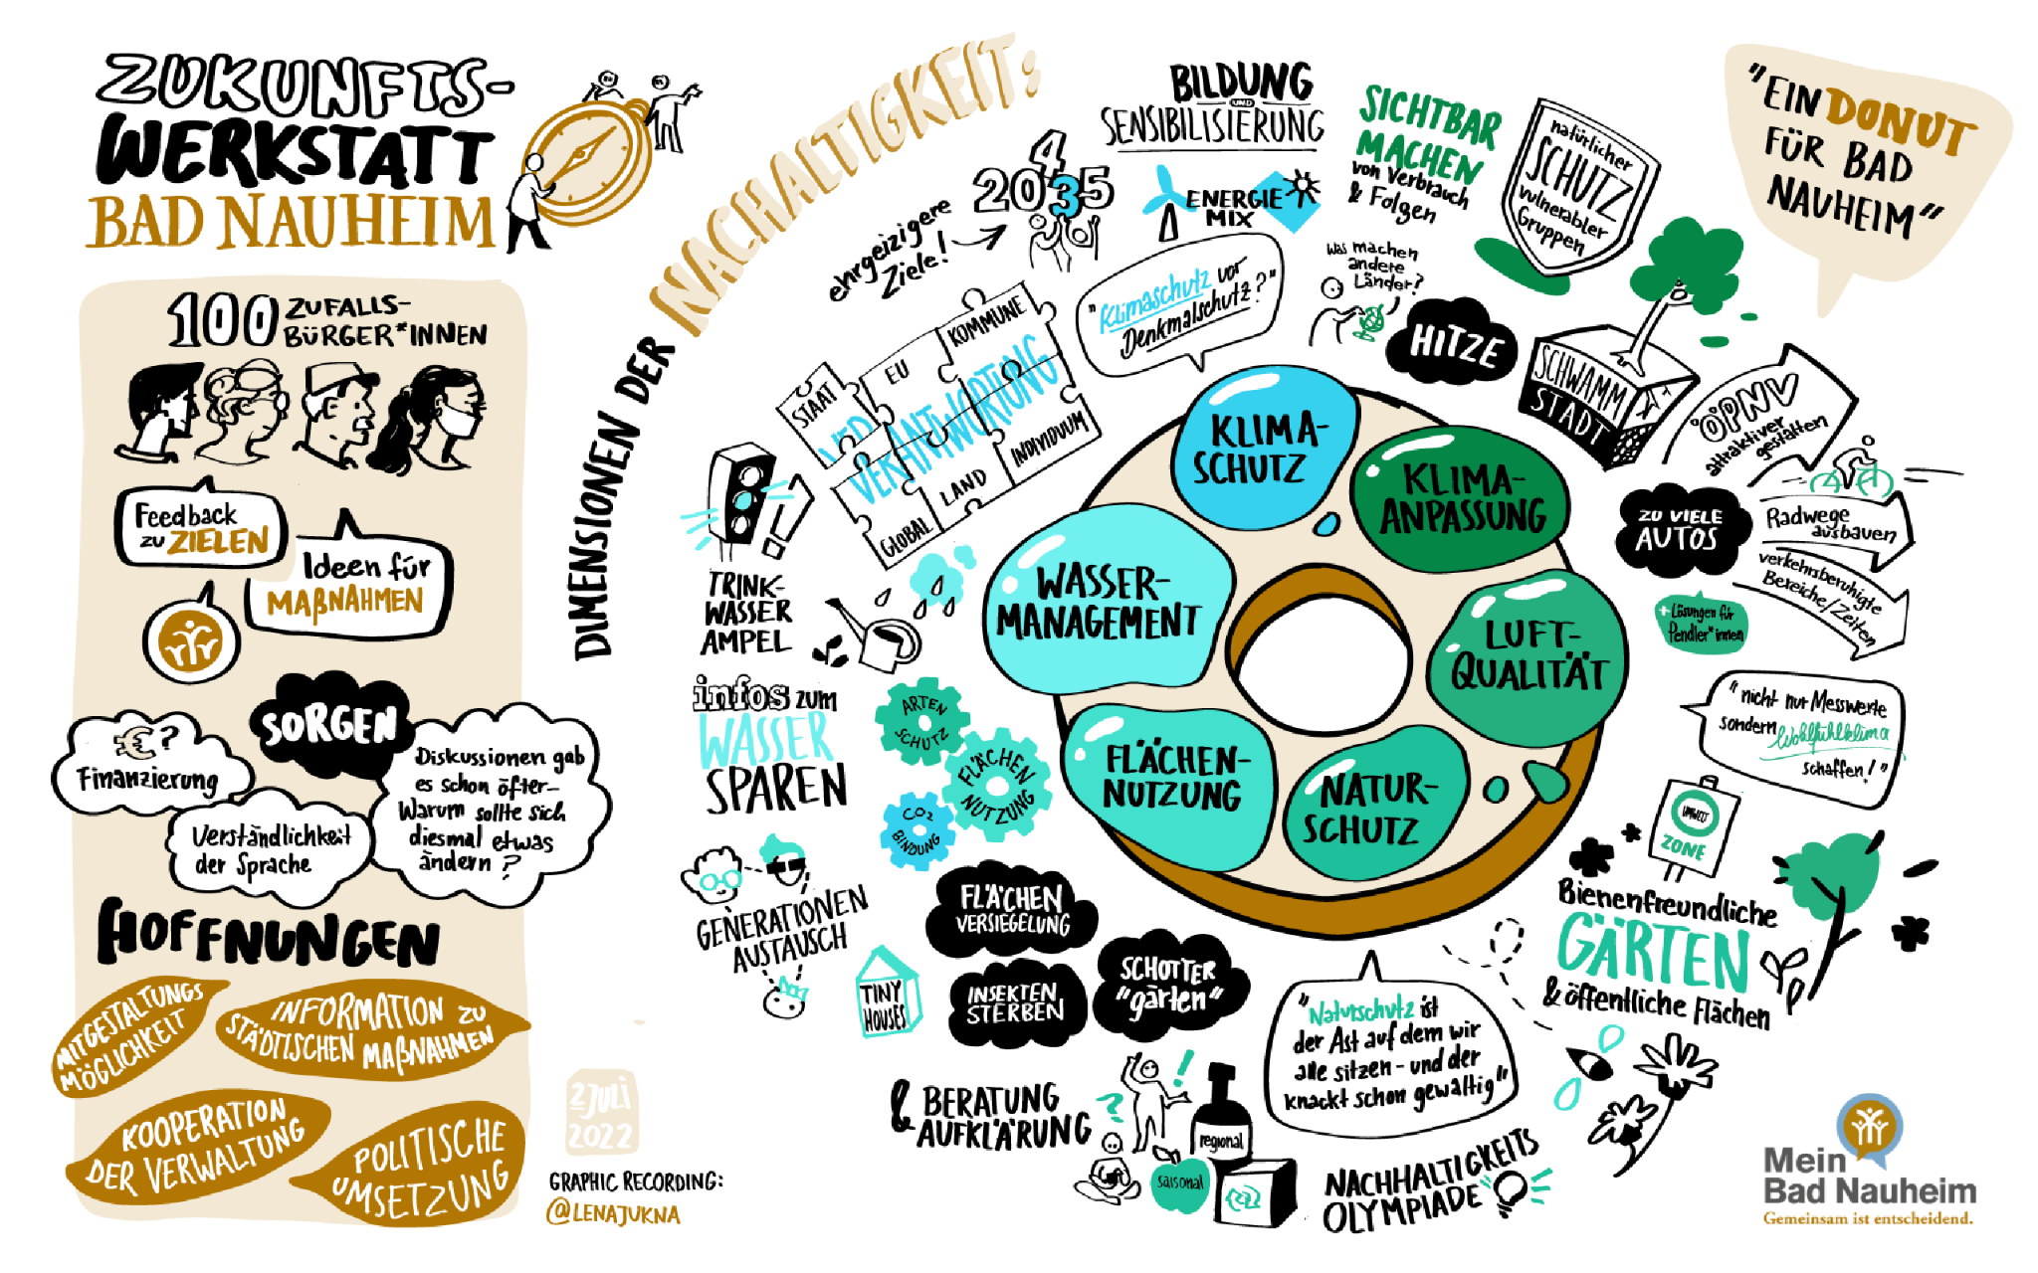
#3 Empowering local change-makers
Workshops in Barcelona, Spain
Donut Deal Day in Amsterdam, Netherlands
Future workshop in Bad Nauheim, Germany
Notes:
Local and regional governments can use the concepts and tools of Doughnut Economics to empower diverse actors in a city in many ways - from working with and supporting existing networks to connect and convene people around the ideas of Doughnut Economics, to amplifying existing activities that are already demonstrating an ambitious and Doughnut-aligned vision, to supporting the transformation and transition of economic activities that need to change. We all know that city governments alone cannot ‘solve’ complex 21st century challenges, as these require a collective effort. And the idea of the Doughnut has shown to resonate with people across different cultures and sectors - from residents, to businesses, to civil society. Cities have used DE to empower local change makers in different ways. IThe City of Amsterdam has been funding various streams of work of the local Amsterdam Donut Coalition, and took parts in this community-led initiative as well. The city of Bad Nauheim in Germany held a Futures Workshop with 100 cities that proposed, selected and developed priority measures of rate city council to deliver, that would help it move inside the Doughnut. The City of Barcelona has been holding workshops with stakeholders from the civil and business sectors.

Slide 13
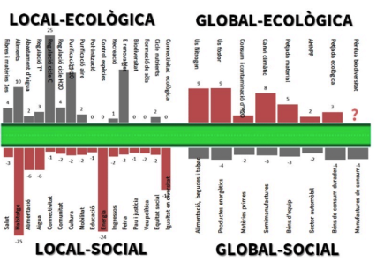
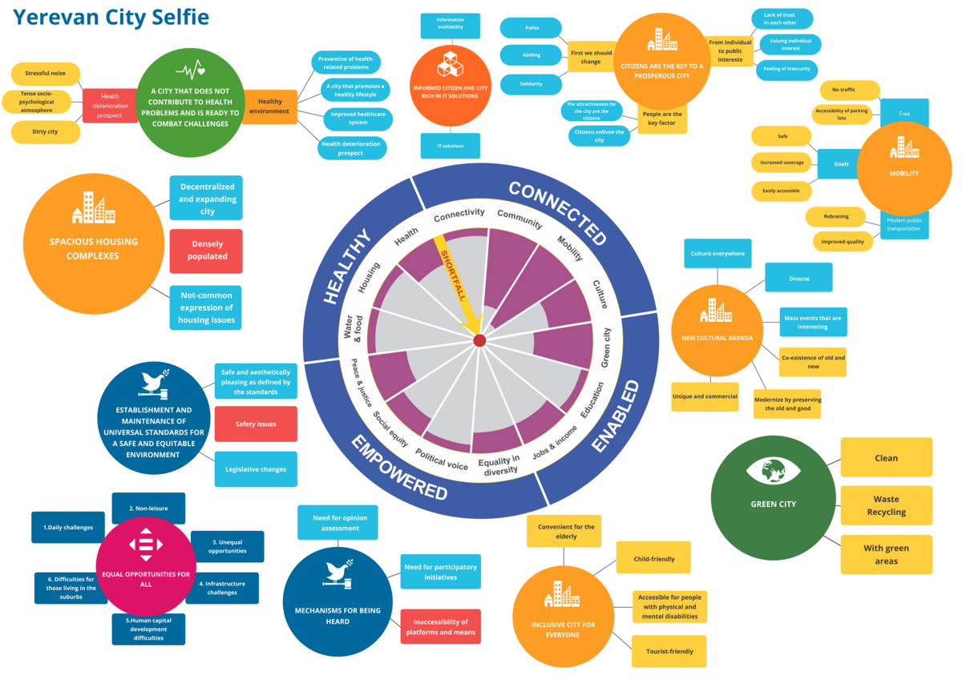
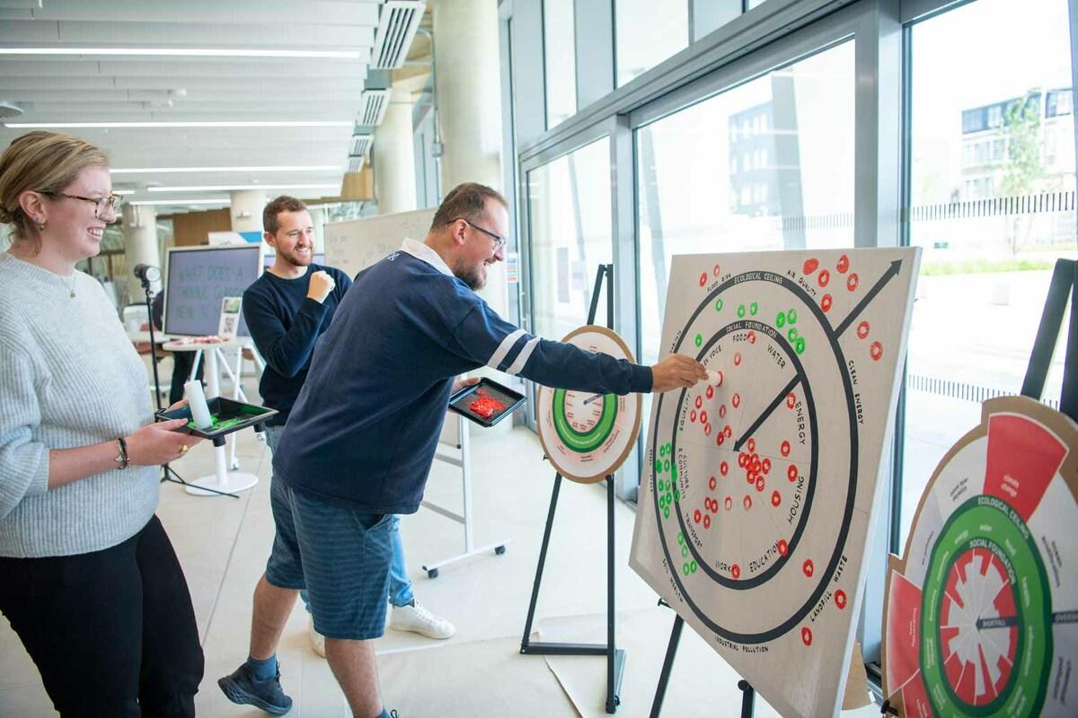
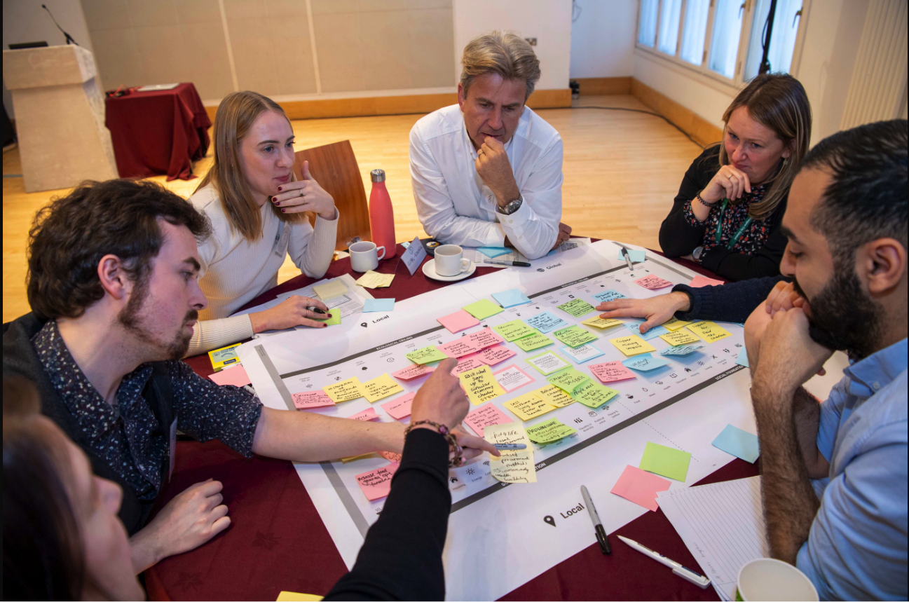
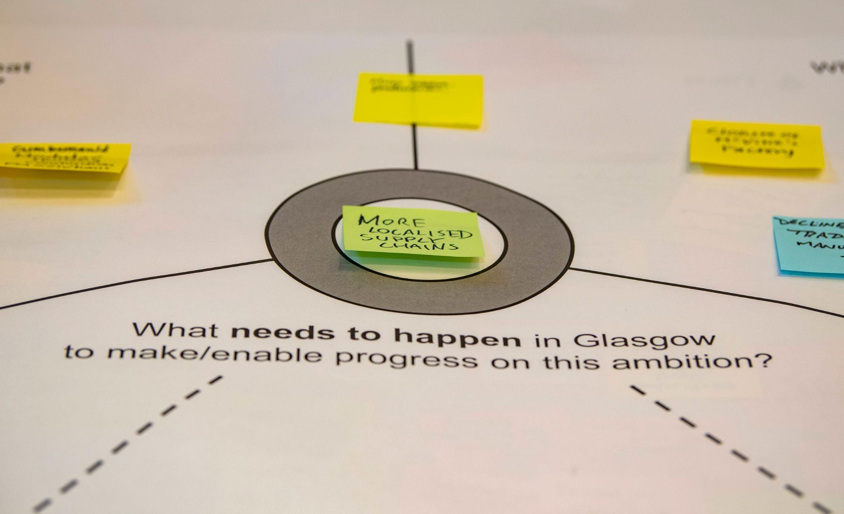
#4 Data, measuring and monitoring
Barcelona, Spain
Yerevan, Armenia
Glasgow, Scotland
Notes:
The starting point to downscaling the Doughnut data approach to a city or region scale is using DEAL’s Data Portrait of Place tool, which provides approaches for gathering targets and indicators and a holistic data snapshot of how well a place is currently doing, measured against its own targets, across both social and ecological dimensions. The Data portrait can be used as a starting point for a range of different activities - from identifying data gaps, to setting new policy targets, to annual monitoring and reporting. Many cities of various scales, from Barcelona and Glasgow, to Brussels, Yerevan, El Monte have developed Data Portraits. In Copenhagen they will be producing an annual status report on Copenhagen based on the Donut, giving politicians an overview of how the city performs and changes across selected, adapted indicators, aiming to inform the work of various departments helping them identify in which areas is action needed, and how to prioritise projects.

Slide 14
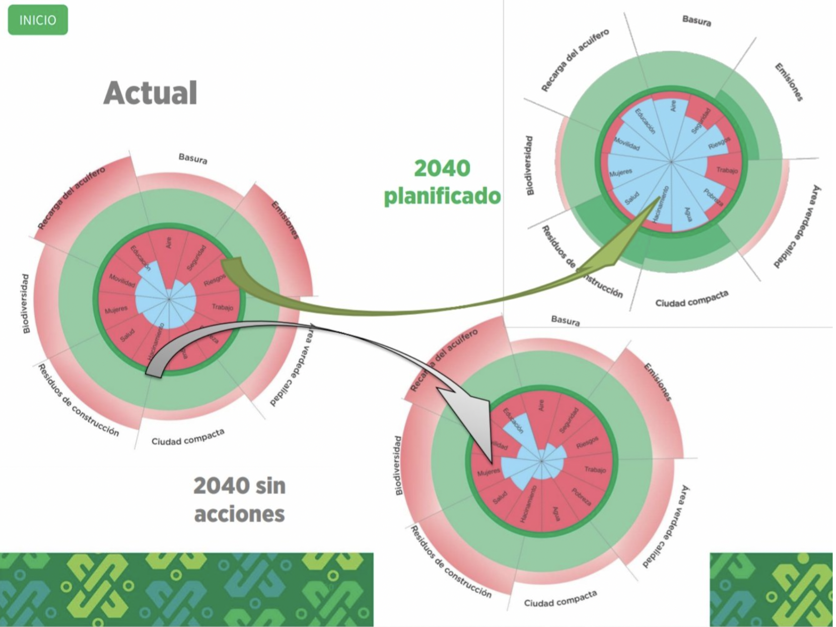
#5 Plans and strategies
Curaçao Doughnut Economy
Amsterdam Circular Strategy
Mexico City Development Plan 2040
Notes:
Local and regional governments can bring the ambitions and metrics of Doughnut Economics into the design, review, monitoring and evaluation of plans or thematic strategies. This could range from shaping a 20-year city vision to a transport strategy, from a net-zero policy to a public health agenda. There are many ways to bring Doughnut Economics into plans and strategies: as a guide for setting an ambitious vision, as a tool for collaborative processes, as a tool to identify key themes, objectives and priorities, or as a tool for designing a monitoring framework with social and ecological indicators based on the Doughnut. Amsterdam (Netherlands) used Doughnut Economics to shape their Circular Strategy, bringing in a holistic view and a stronger focus on social outcomes. Curaçao’s Economic development strategy uses the Doughnut as a compass for ‘economic prosperity’, and was informed by a series of neighbourhood workshops identifying existing initiatives through the lens of Doughnut Economics.Mexico City (Mexico) used a contextualised Doughnut as a tool for discussion and resident engagement in their 20-year Development Plan, visualising where the city currently is and where they want to move towards in the long term.

Slide 15
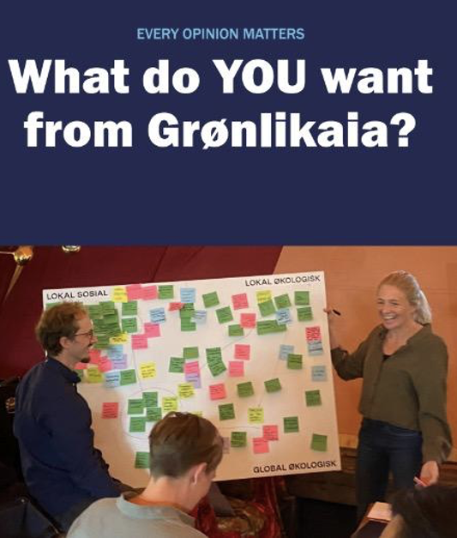
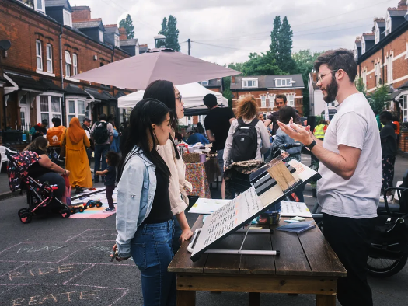
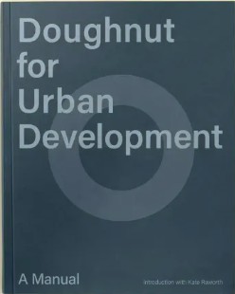
#6 Demonstrator projects
Oslo, Norway
Development in Oslo, Norway
Retrofitting a street demonstrator, Birmingham, UK
Urban development Manual
Notes:
Local and regional governments can support or fund the design and development of projects aiming to be distributive and regenerative by design, using the tools of Doughnut Economics to achieve this. These demonstrator projects might be designed to have a positive impact across all four lenses of the Doughnut, set best-practice precedents, demonstrate potential cobenefits, test what is achievable, viable, and scalable, or start conversations and debates. Equally, Doughnut-related criteria could be developed to select and prioritise projects or investments. There are many demonstrator projects emerging, particularly in the built environment. In Grønlikaia, a new fjord district in Oslo (Norway), Oslo Port’s development company has been using the four lenses of a Doughnut to bring diverse experts together, identify opportunities, gaps and solutions for the future neighbourhood. Neighbourhood lab CIVIC SQUARE anchors their ‘Street demonstrator’ in the core principles of Doughnut Economics, as they attempt to develop a street-scale deep retrofit approach on one street in Birmingham (England). Doughnut for Urban Development is a Manual that was created by a collaboration between practitioners and researchers setting a starting point for those planning, developing and designing buildings to work with the ambitions and four lenses of the Doughnut.

Slide 16
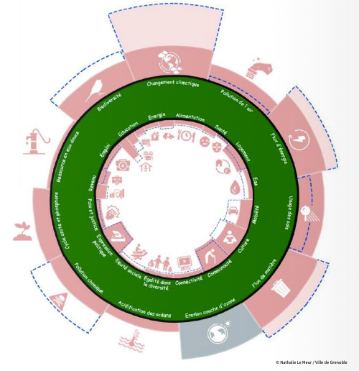
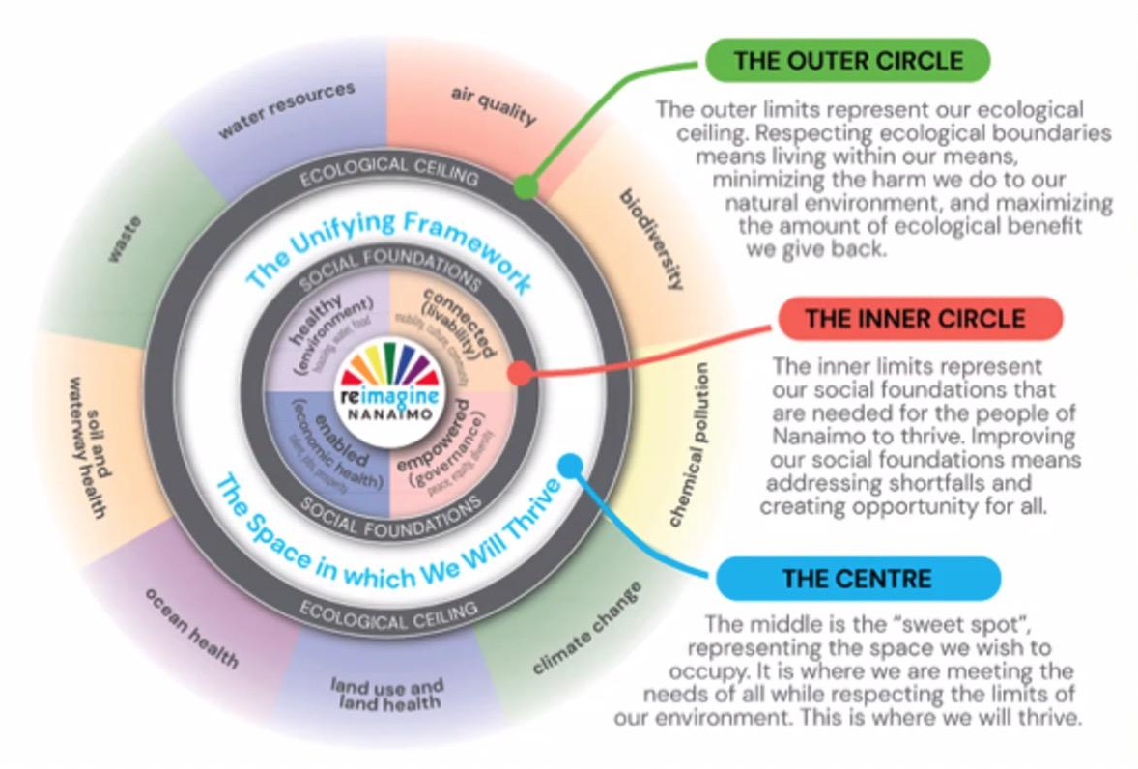
#7 Doughnut Economics as a strategic compass
Doughnut Economics framework in Nanaimo, Canada
Grenoble 2040 approach, France
Notes:
Local and regional governments can adopt Doughnut Economics as a strategic compass or a guiding framework in their transformative journey. This high-level and high-ambition political commitment could take the shape of a council or mayoral decision setting a commitment to a process or a vision. There is no single approach to using the Doughnut as a compass, but generally, it requires embracing a mindset and culture shift (or aligning to an already ongoing ambitious shift) and making Doughnut Economics a common guide and reference for many streams of work and action, like planning, strategy, decision making, engagement or budgeting. Places like Nanaimo have adopted an official commitment through a council motion “to adopt the Doughnut Economic Model as. Cohesive vision for all city initiatives and planning processes”, the Brecon Beacons National Par put the Doughnut at ht score of their Management Plan as a framework defining future action, and Grenoble in France adopted the Grenoble 2040 approach underpinned by Doughnut Economics. As this pathway implies a longer term commitment, most places dedicate time and resources to studying and adapting how Doughnut Economic could be applied in their own place - for instance in Tomelilla, Sweden they had the RISE (research institute) produce a study exploring the DE potential for them, in Copenhagen an inter-departmental task force was created.

Slide 17
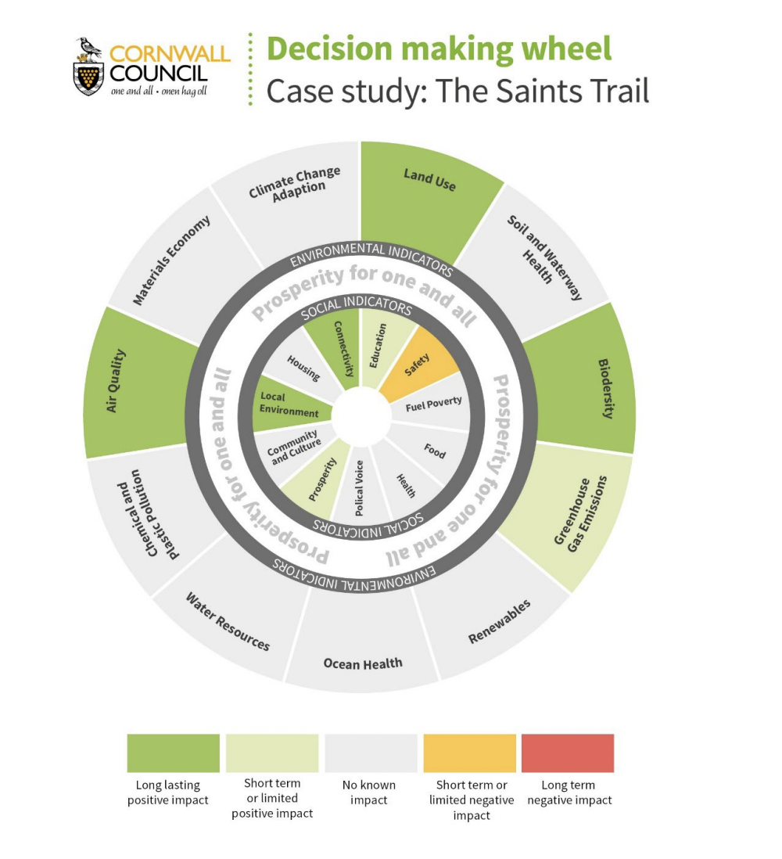
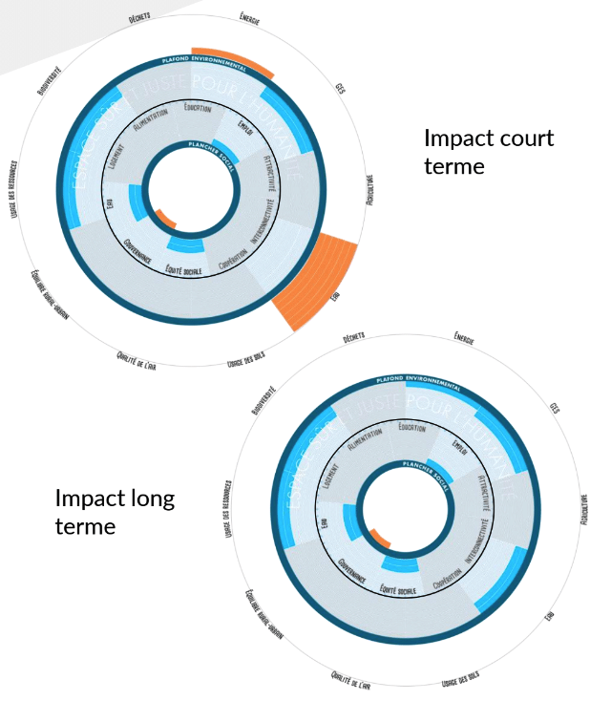
#8 Decision making and project assessment
Decision making wheel, Cornwall, England
Project impact assessment, Valence Romans, France
Notes:
Local and regional governments can develop tools and criteria through which the potential impact of projects, policies or investments can be assessed against social and ecological indicators, informing decisions. These tools and approaches could be either obligatory or advisory. In Cornwall (England), the council has introduced the Cornwall Development and Decision Wheel (CDDW) for cabinet-level decisions, illustrating the positive and negative impacts of proposed decisions in a visualisation that focuses decisionmakers on issues that may require further debate, mitigation or cancellation. CDDW is an accessibleto-all-staff, interactive, digital platform, where users can fill in a questionnaire on any project or initiative across social and ecological themes and, based on the quantitative answers, scores are assigned to each ‘wedge’ and a Doughnut-shaped visual is produced demonstrating the potential impact of the project (long-term negative, short-term negative, neutral, short-term positive, long-term positive). They also created a training programme and guidance for key decision-makers, including workshops for the new administration. In Valence Romans (France), they have developed a Doughnut project-assessment tool specifically for measuring and tracking the impact of 20 projects that are part of the 5-year municipal programme; improvements are identified, adjustments and changes are made, based on the assessment.

Slide 18
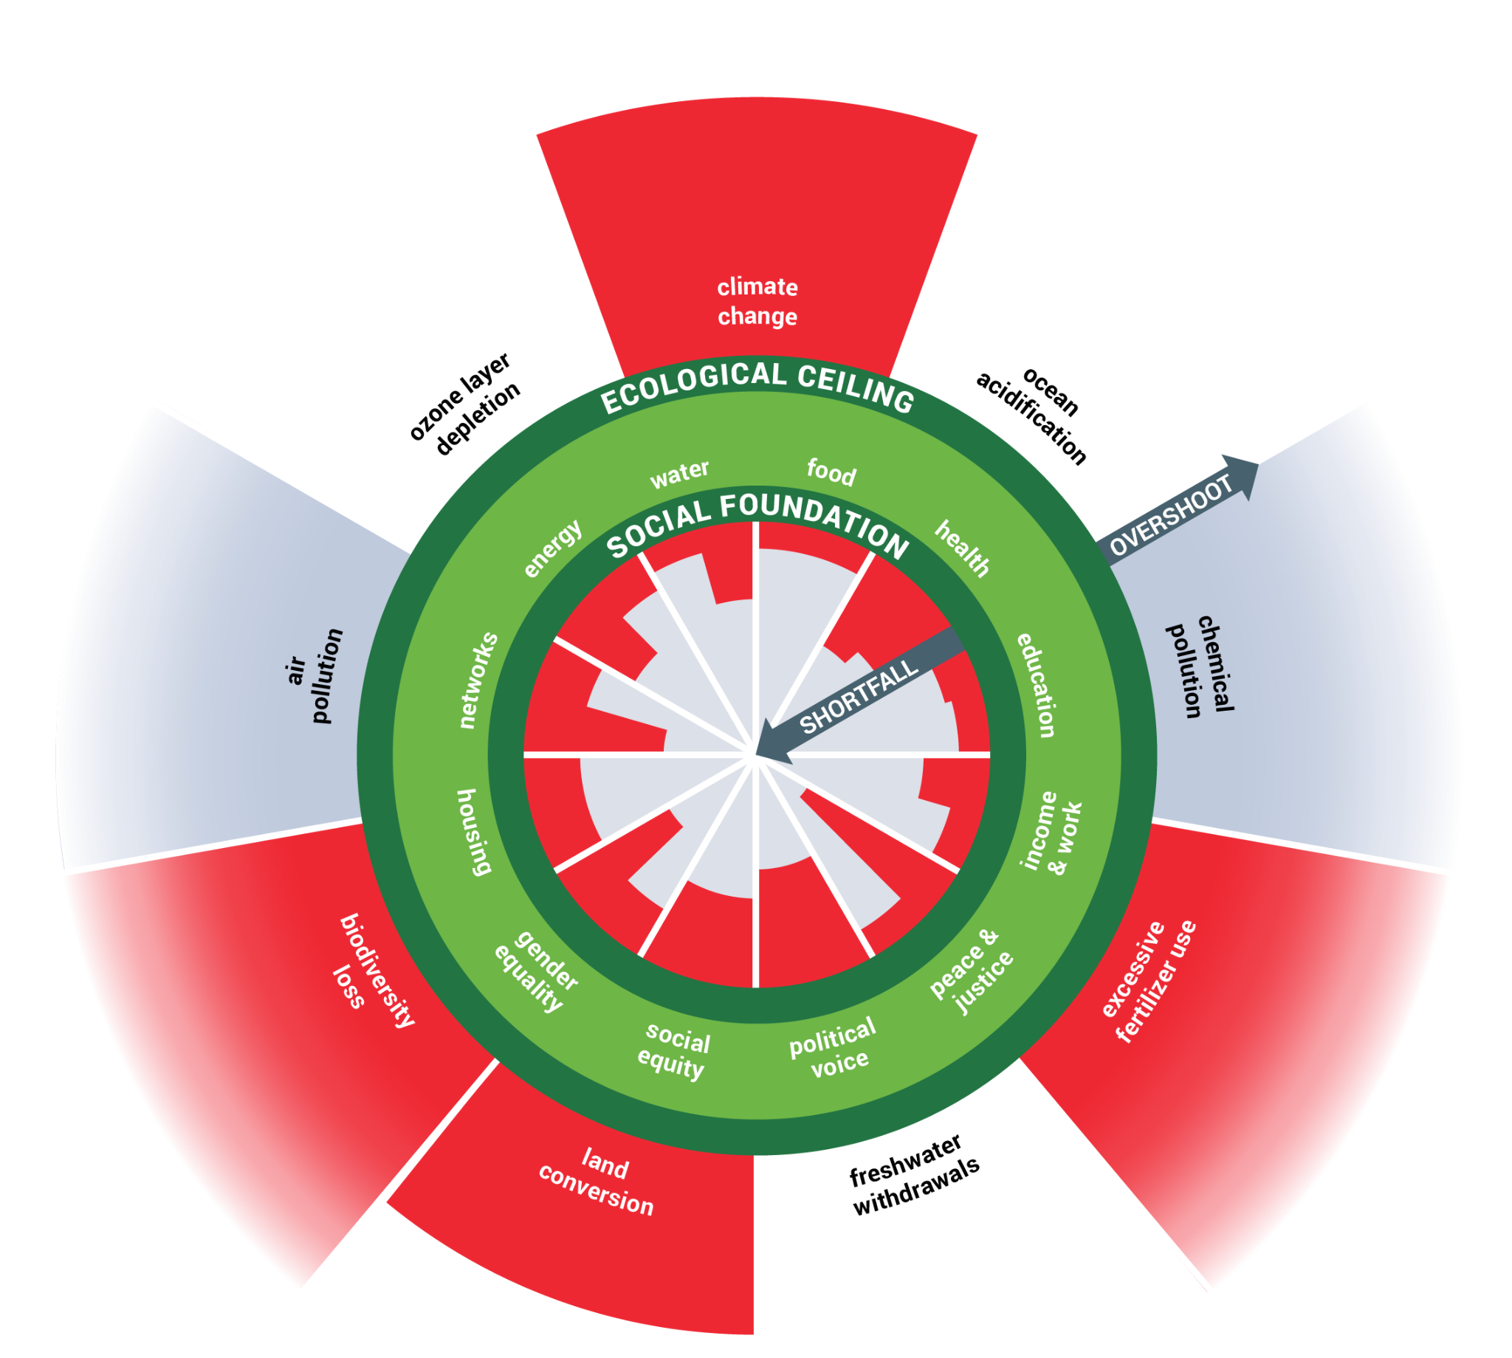
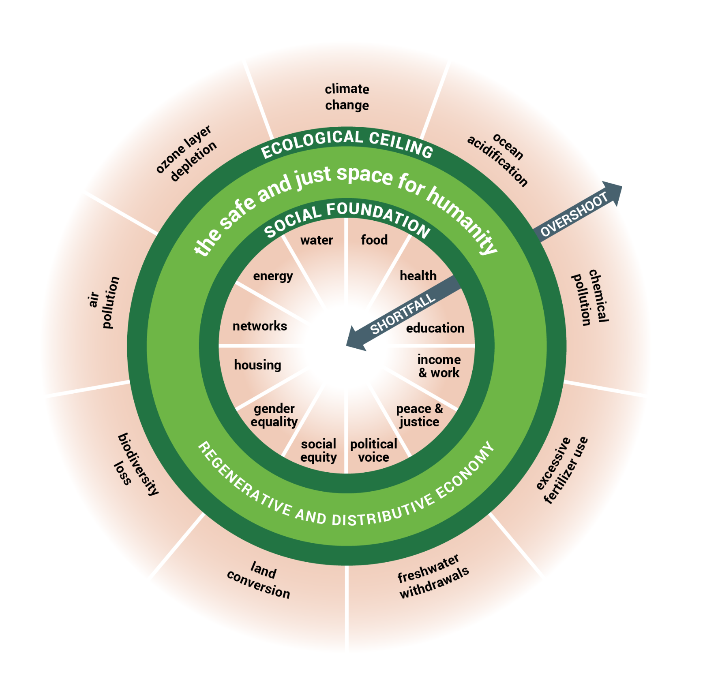
#9 Identifying levers of transformative change
purpose
networks
governance
ownership
finance
Which aspects of our design are holding us back?
How can our design move us faster to a thriving future?
Notes:
Finally - while we’ve referred to this as the 9th pathway, it really is something that should underpin and lie at the core of all other work - the process of continuous systemic transformation, identifying levers of transformative change. Most places aiming to do transformative work hit obstacles that are deeply ingrained into local institutions’ ways of working, path dependencies and other patterns inherited from the past. Often hidden beneath the apparent banality of day-to-day operations and business-as-usual planning, lie structures that can enable or block transformative change (e.g. decision-making mechanisms, land ownership, finance). This final pathway invites places to acknowledge and confront structural barriers, and boldly identify leverage points for overcoming them. We propose a framework we call the ‘Deep Design of Cities and Places’ as an entryway into this process, though there are many other ways to start conversation and action. The Deep Design framework looks at these 5 layers of organisational design, inviting local governments to ask questions and enquiry where change can be unlocked, link to a workshop tool using this framework: https://doughnuteconomics.org/tools/167

Slide 19
#9 Identifying levers of transformative change
Purpose
What is its purpose? Why does our local government organisation exist? What end does it serve in the world - and is that vision shared by all involved?
Networks
How it is networked? What relationships does our local government hold, and how does it bring its purpose and values to life through them?
Governance
How it is governed? How are decisions made and by who? What are the hard rules, and the unwritten culture of how things get done? What are the metrics of success?
Ownership
How it is owned? What are the land, assets, data that this local government own and doesn’t own, and who benefits or loses from these ownership models?
Finance
How it is financed? What are the sources of finance here, and what does that finance expect and demand? What is extracted, what is reinvested and who does it serve?

Slide 20
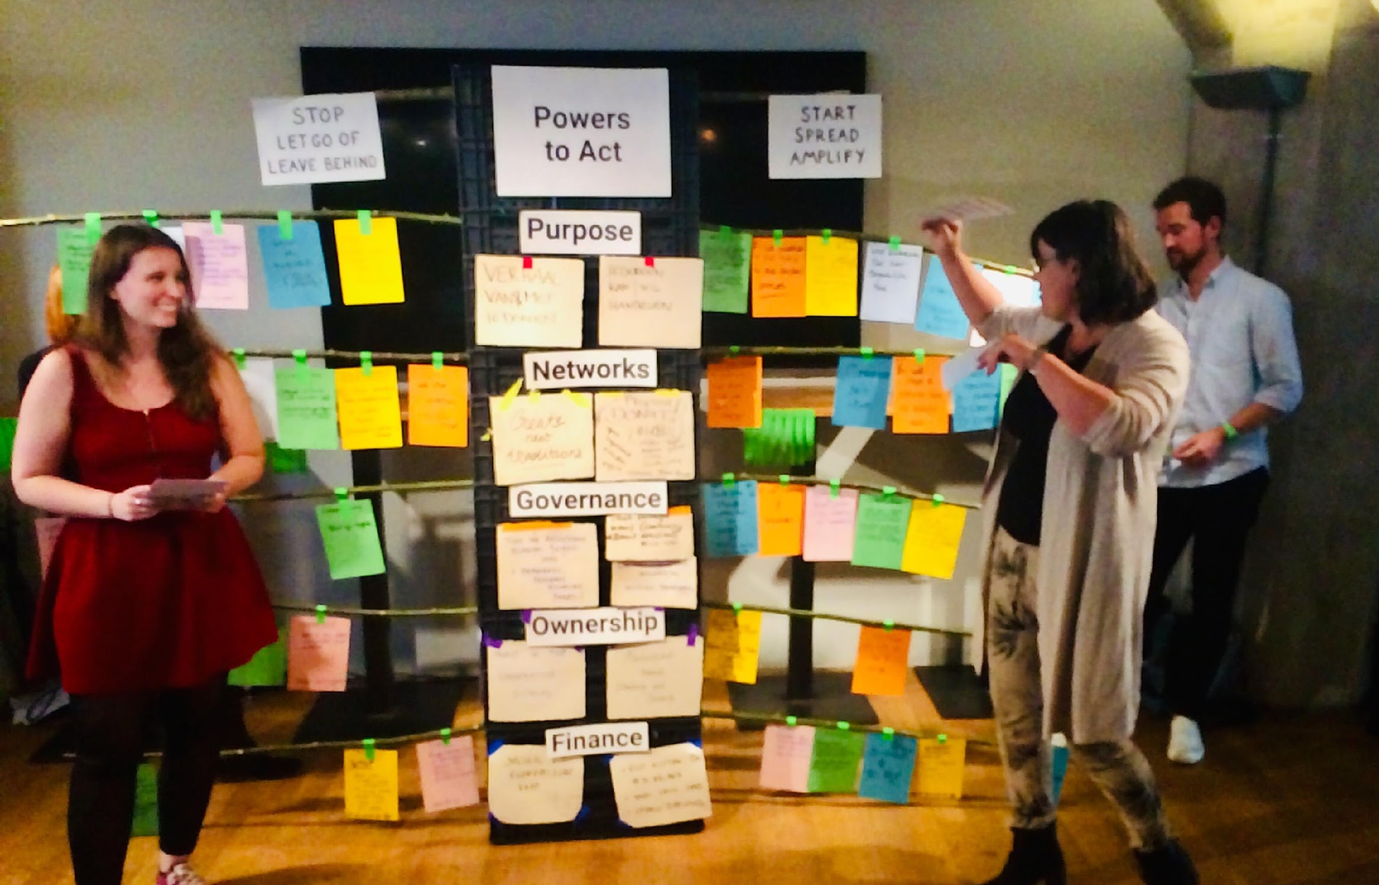
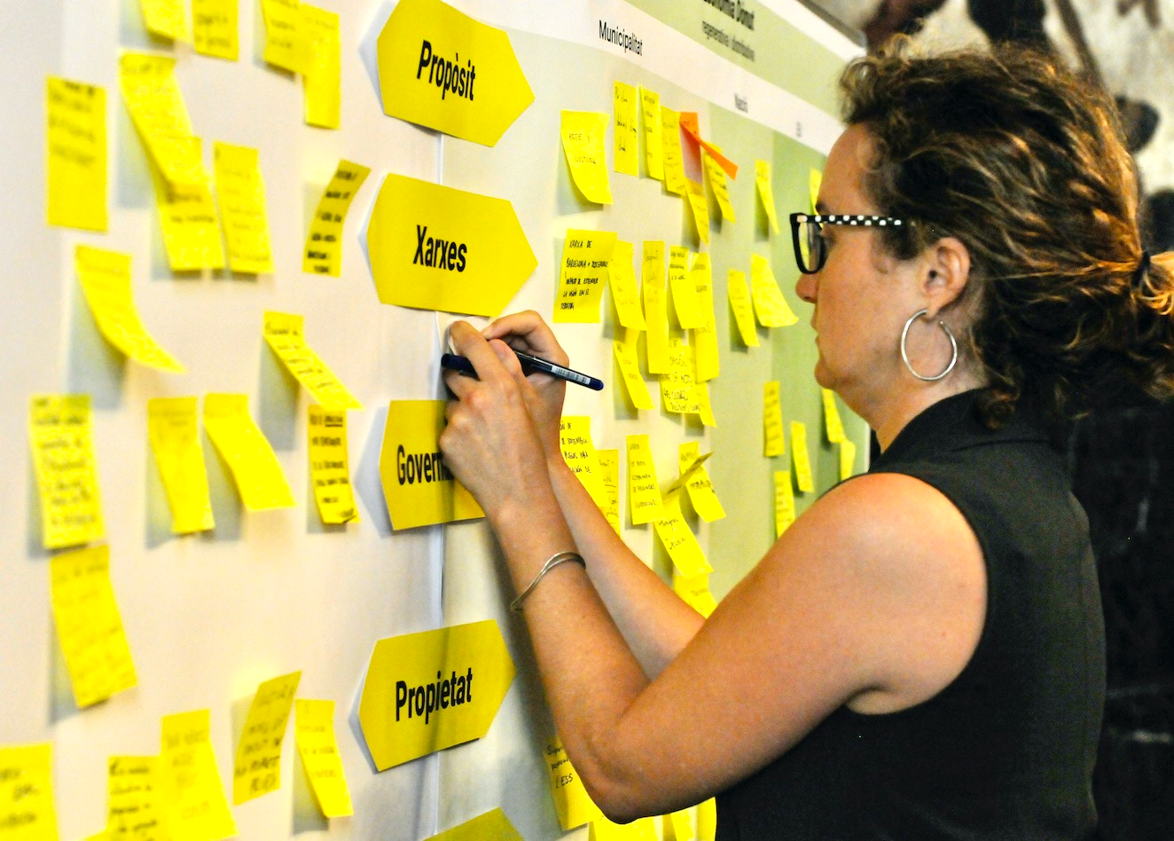
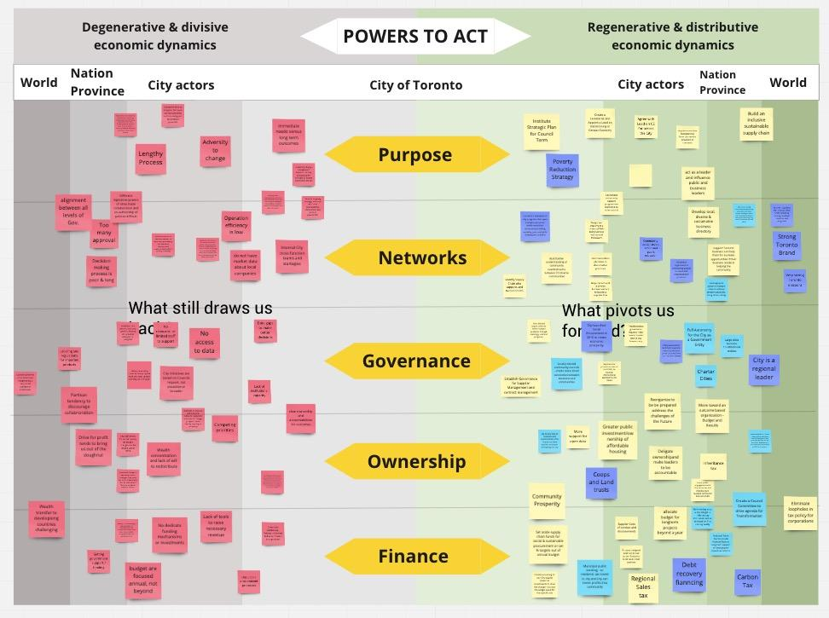
#9 Identifying levers of transformative change
Amsterdam
Ipoh
Barcelona
Toronto

Slide 21
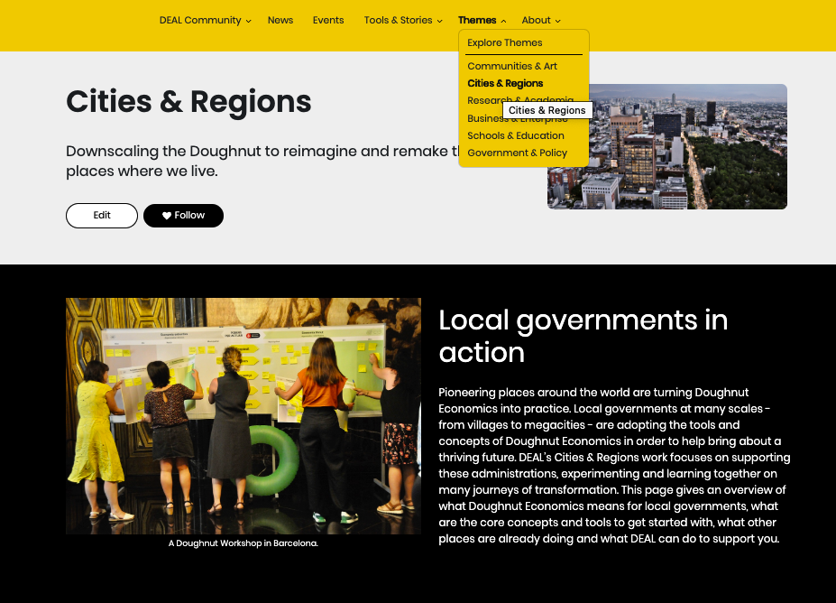
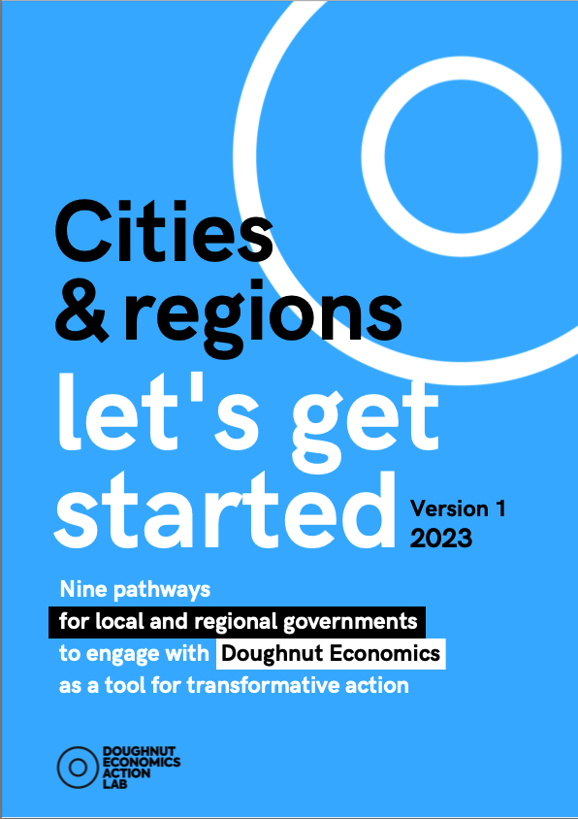
DEAL’s tools and the community of practice
doughnuteconomics.org
Notes:
The nine pathways are in Let’s get Started. A guide for everyone - that aims to be the one-stop shop linking to all other tools and resources on DEAL’s platform that are relevant and useful for local governments, as well as to case studies and stories of action.

