Slide 1
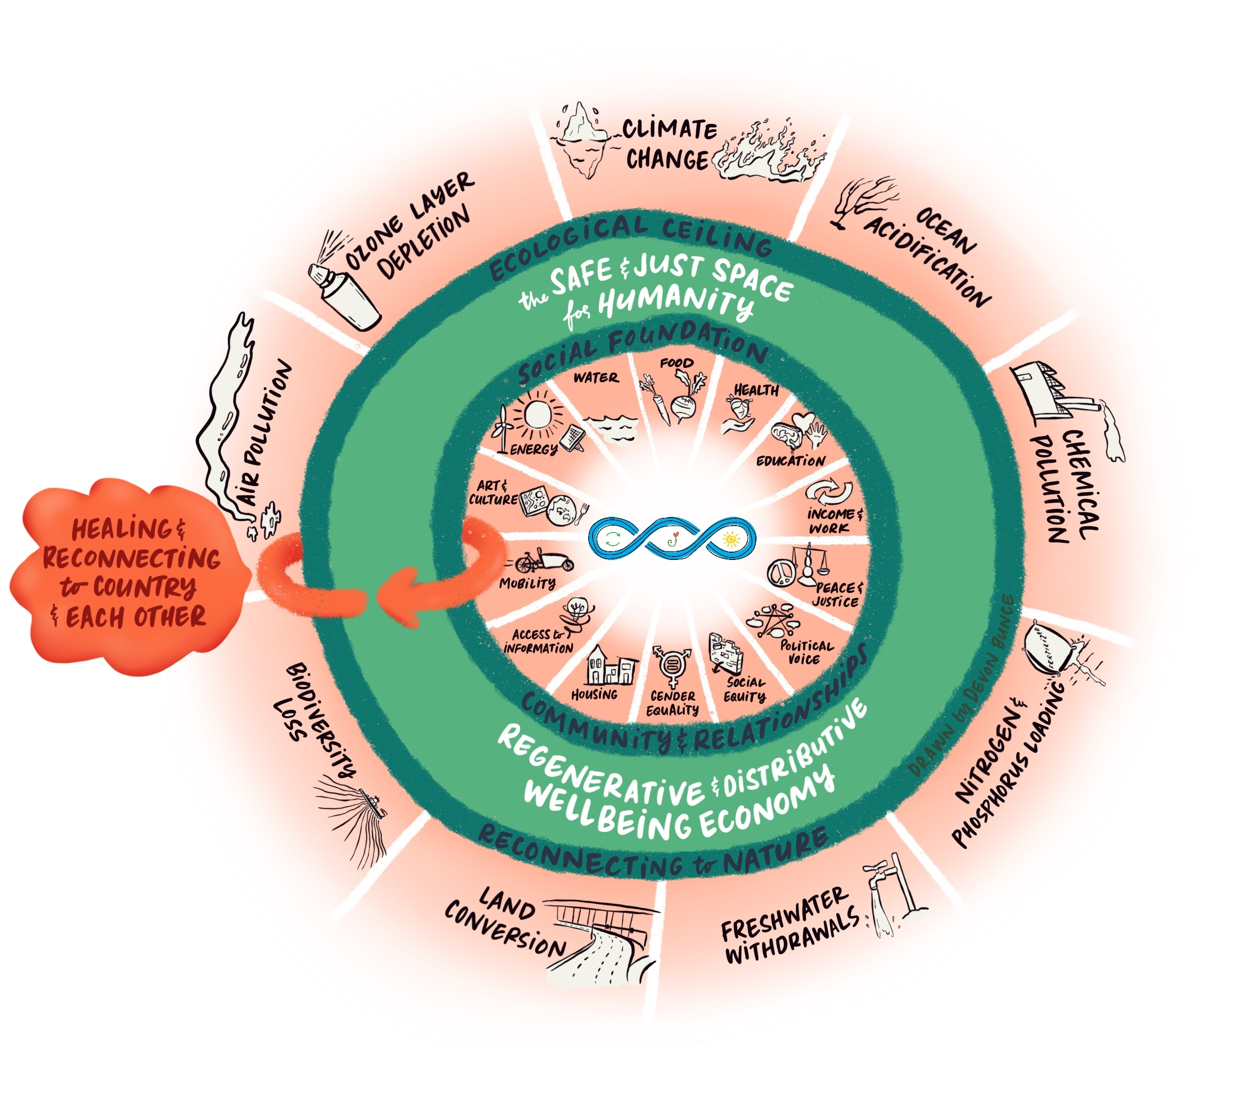
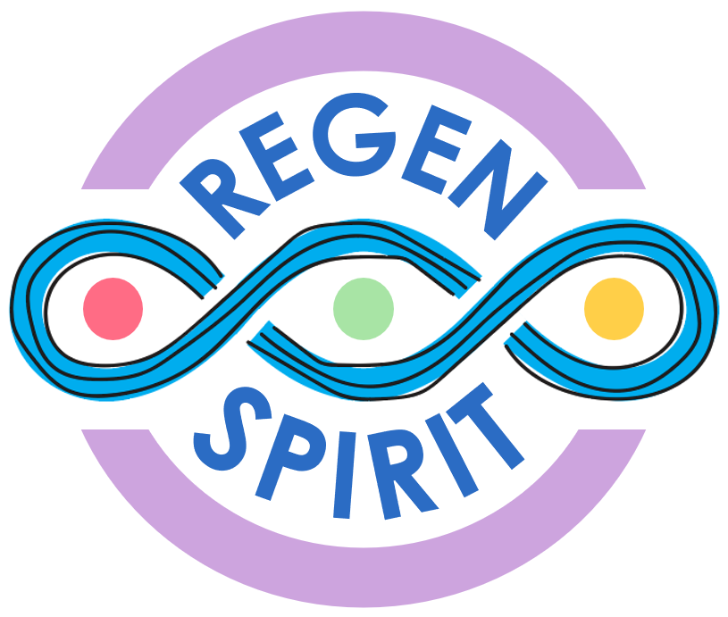
SPIRIT
REGEN SPIRIT
Quiet-Everyday Leadership
The Smallest of
Daily Things
Our
Thoughts
+
Awaken Caring
=
Being
Our
Actions
+
Focused
Attention
=
Doing
Our Language
+
Open Awareness
=
Knowing
REGEN
Developmental
Aims
(
)
A safe, just, regenerative & distributive
wellbeing economy
Time
+
+
=
To improve, regenerate and then sustain
the sources of wellbeing and vitality for all

Slide 2
Regen Spirit is a method to activate Doughnut Economics’ principles across multiple-levels (personal, neighbourhood, community, city and state) simultaneously, creating lasting change, creating positive ripple effects that spread far and wide. Regen Spirit adopts a Quiet-Everyday Leadership approach, that starts with the first three step of regenerative leadership – The smallest of daily things: Our Thoughts Our Actions Our Language to improve, regenerate and then sustain sources of wellbeing and vitality for all. Wellbeing and vitality of self, others and nature, wellbeing and vitality of Me & We, Place & Planet, wellbeing and vitality accessible to everyone, everywhere.
Regen Spirit’s Quiet-Everyday Leadership is underpinned by three foundational theories and three developmental aims to guide the first three steps and advance Collective Action from Shared Awareness (CASA – Otto Scharmer).
Foundational theories and developmental aims
Benefit Mindset is concerned with the life-long process of learning how we can be the transformation and realise our unique potential in a way that serves the wellbeing of all. Benefit Mindset (Buchanan & Kern, 2017)
Beneficial Action which is about prosocially and altruistically motivated behaviour that uses consequential (scientific) knowledge to increase freedom within the global population. Beneficial Action (Toumbourou, 2016)
Beneficial Literacy is the capability to comprehend and compose beneficial language, across contexts, with the intentionality (desire, belief, intention, skill and awareness) of using such language for the mutual benefit of self, others and nature. (Wright 2021, adapted from Wellbeing Literacy (Oades et al, 2021)
Awaken Caring about and for self, others and nature
Focused Attention into safe, just and regenerative collective action
Open Awareness to our highest future possibility
Combining the first three steps with the theories and aims creates new regenerative ways of Being, Doing, and Knowing, their combined effect is greater than the simple sum of their parts and generates a system-wide positive ripple effect.

